Slide 1
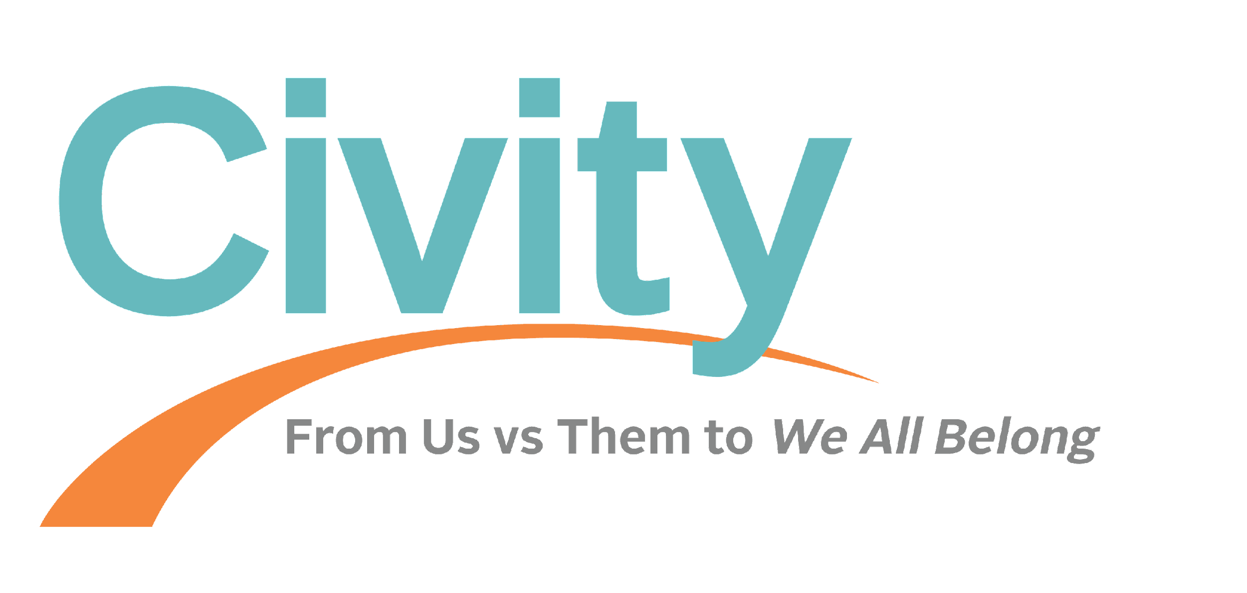
civity:
(noun)
A culture of deliberately engaging in relationships of respect and empathy with others who are different.
Notes:
Civity is a word we appropriated from the Latin word for “city” (the PEOPLE in the city, not the buildings) to describe the change we want to see (read definition)
We deal with a lot of differences, but tend to focus on the divides that keep us apart – e.g., race, economic status or class, and politics

Slide 2
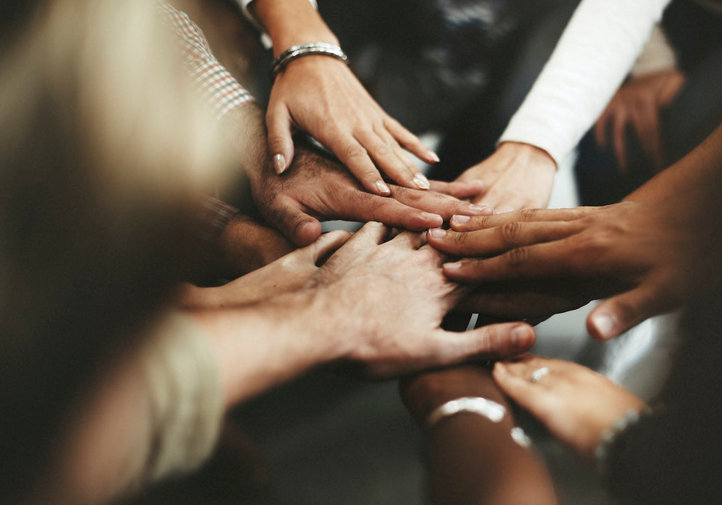
Relational
Infrastructure
Notes:
We are about building “relational infrastructure.”
Infrastructure is the structures, facilities, and organizations that a society or community needs to function – physical, civic – and relational – the relationships that make it possible for people to get things done
When we say “building relational infrastructure,” what we’re talking about is conversations that create relationships

Slide 3
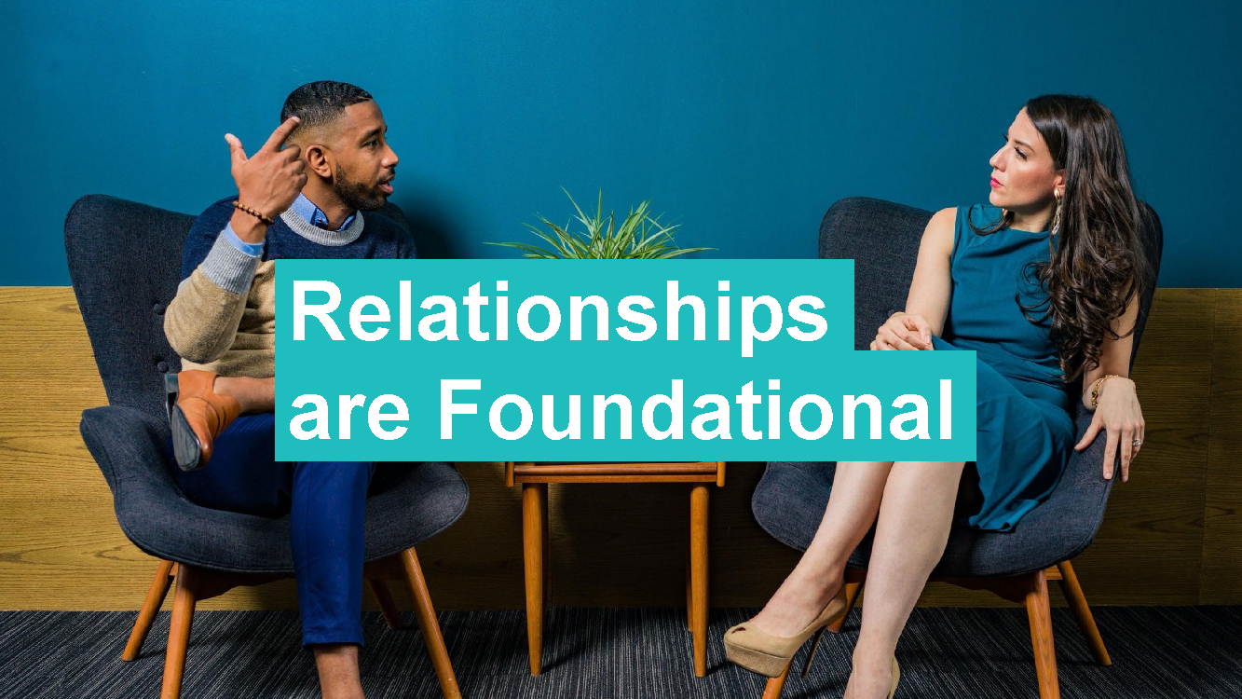
Relationships are Foundational
Notes:
Civity work is centered around 3 pillars of how cultural change happens in communities: First, relationships are foundational.

Slide 4
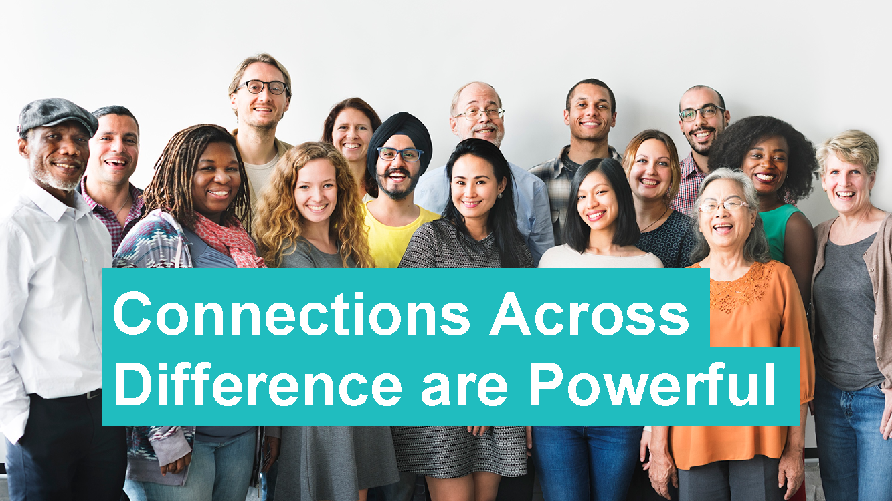
Notes:
Second, connections across difference are powerful. The relationships that bridge across social differences are what make it possible for communities to pull together.

Slide 5
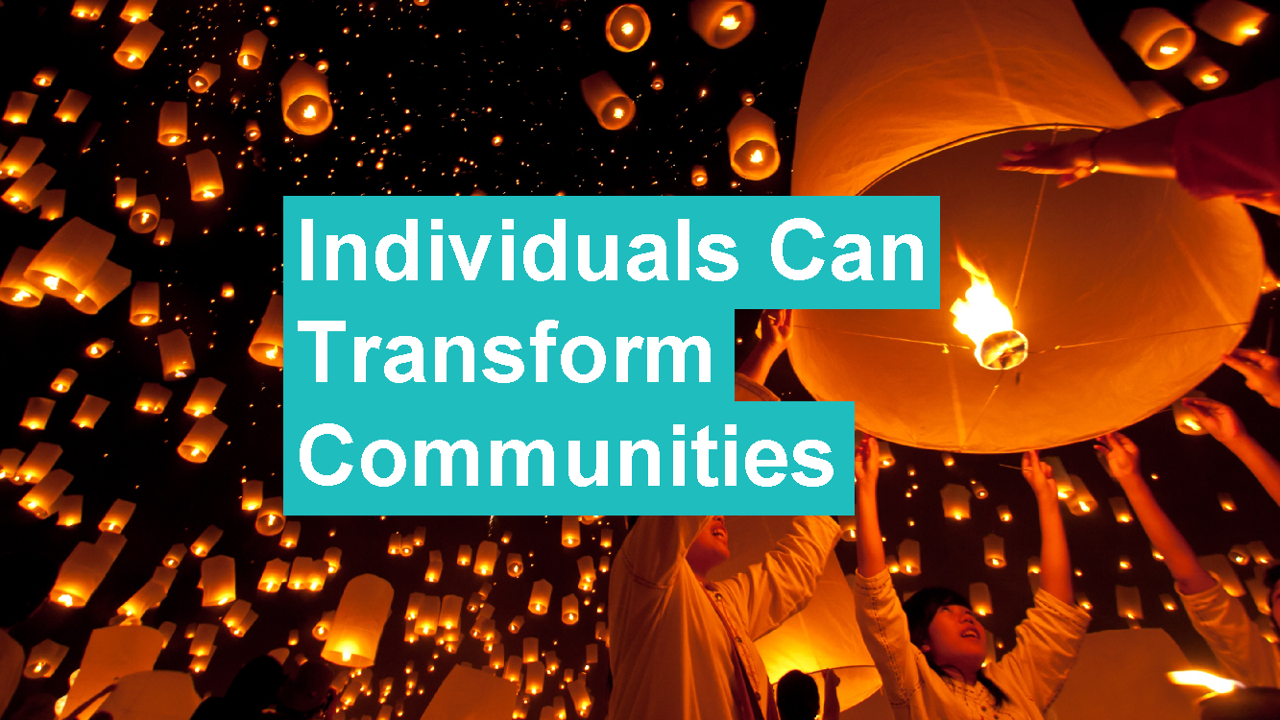
Notes:
And third, changing relationships between people can change the culture – and changing culture can support policy changes. We can change the system because we are the system.
In systems – social systems like our institutions and communities – what people do up-close, with the people we interact with, in our everyday lives – this ripples out and scales up to create the culture of a place, the way people in it are with each other.

Slide 6
When it comes to building relationships
Conversation = Action
Notes:
(Read slide)
People can discount conversation as “just talk” and are eager to get to “the action,” but …
Conversations build relationships, and when the work is building relationships, conversations are action - and the core of this workshop

Slide 7
Stanford Study: Civity Helps Strengthen Democracy
#1 at increasing social trust
#4 in reducing partisan animosity
Notes:
Recent Stanford-based study: the Strengthening Democracy Challenge
252 entries; 25 tested
Call out to academics and practitioners to enter. Civity’s 8-minute online intervention, Civity Storytelling, was #1 at increasing social trust and #4 in reducing partisan animosity
And these results were durable over time
Small is significant; how we interact with other people matters

Slide 8
Notes:
Social trust is foundational to democracy
It’s a generalized sense not only that other people matter but that other people think that I matter too
This kind of reciprocity makes governance for and by “we the people” possible
Historically, “We the People” sounded good but really meant only “some of the people” – it was “We the People” with an asterisk, with a caveat, with exclusions – a limited “We the People”

Slide 9
We the People
Notes:
A civity culture, a “We All Belong” culture that reaches across differences, has no asterisks – it’s bigger and more expansive

Slide 10
Civity Adds a “Horizontal” Dimension to Power Dynamics
Notes:
We understand that many differences between people are differences of power. That is, our society is constructed so that these differences make one person have more power than the other.
Civity conversations don’t eliminate power differences between people, but they do add a person-to-person, “I see you as a fellow human being” horizontal rather than vertical thread to the relationship.
In other words, Civity adds complexity to power differences.

Slide 11
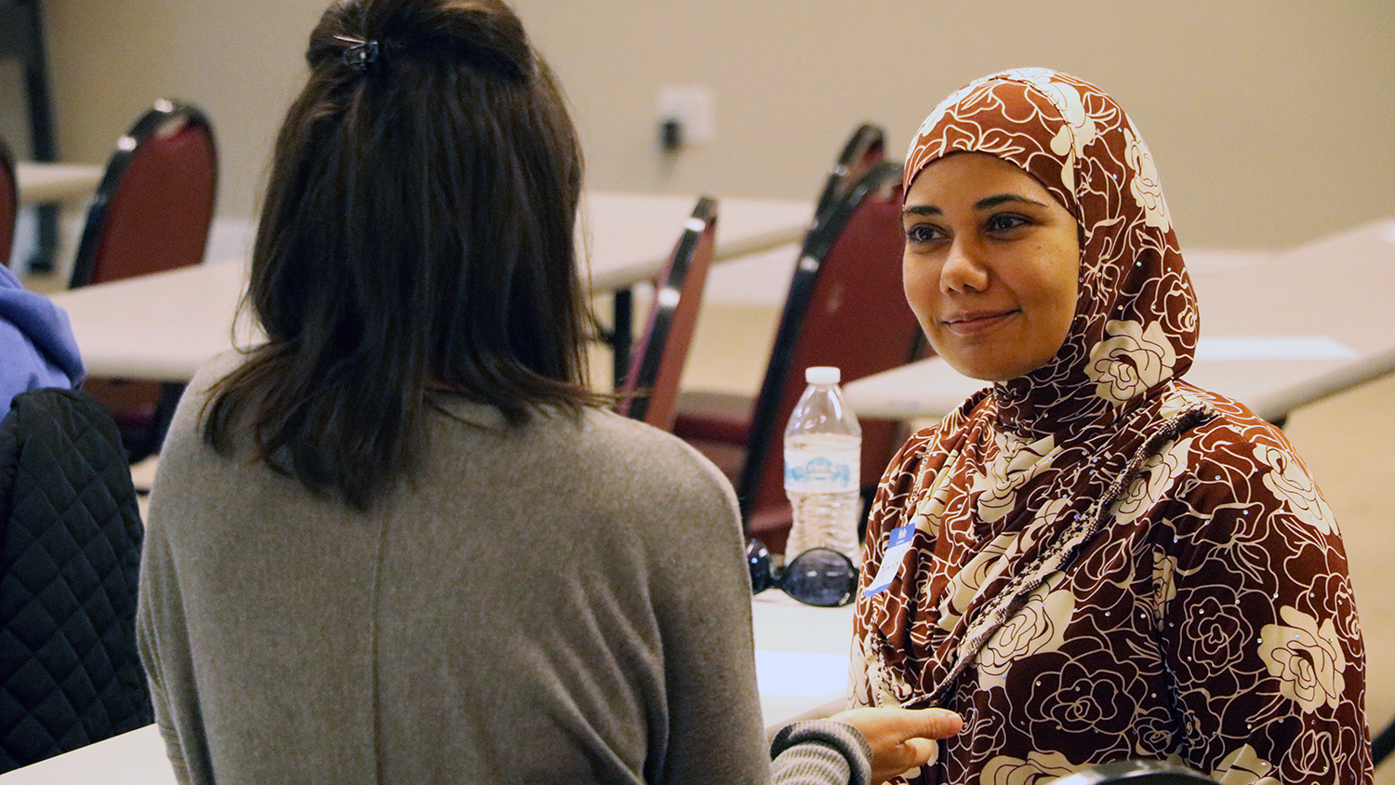
Intentionality
Authenticity
Put difference on the table
Notes:
What are we going to do today?
We’ll practice three things:
Intentionality (we’ve already covered that) – attention and intention
Authenticity AND
Putting difference on the table (where we’re headed)

Slide 12
“A story
is the shortest distance between people.”
- Pat Speight
Notes:
Civity conversations – and this workshop – put stories at the center
Stories reach our hearts as well as our heads
Story-telling and story-listening get us to that 2 ½-3 level, and they create space for respect and empathy

Slide 13
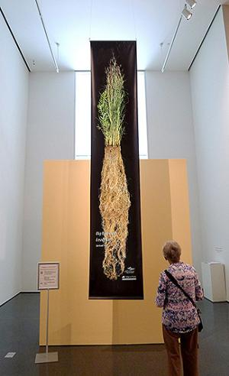
Prairie Grass Reflection
Notes:
-Here you will see a photo of me on the left in NE, standing in the Loess HIlls among lots of Big Blue Stem prairie grass.
-On the right you will see the depth of prairie grass roots - 8-14 feet. We believe that people are like prairie grass - we have elements of ourselves that are visible to the eye, but there’s a lot of depth and complexity to us beneath the surface.
-During our “putting difference on the table” exercise, I will mention this prairie grass reflection…to think about the complexities of your identities. We will come back to this

Slide 14
Resources for You
Civity/Stanford Storytelling Intervention
Workshops
Taste of Civity (1.5 hours)
Experiencing Civity (2-4 hours)
Train-the-Leader
Coaching & Train-the-Trainer
Story-Telling (newsletter & podcast)
Do-It-Yourself Civity (coming soon!)
www.civity.org
Notes:
We have a lot of offerings as you can see – we want you to reach out to me to CUSTOMIZE it to meet your needs
Our work at Civity is supporting people who are practicing and seeding civity
The Civity Storytelling intervention is available for people to watch, to show to groups
We do workshops – virtual and in-person – one-hour “Tastes of Civity,” longer “Experiencing Civity” workshops in which people can begin or deepen their practice of civity, “Train-the-Leader” workshops that prepare leaders to seed civity, to bring civity to other people
We also do coaching and “Train-the-Trainer” for people who are in a position to themselves train others
We share stories of people creating civity, and by doing so help people see what is possible
And, coming soon, we will have a part of our website devoted to DIY Civity – how to build civity on your own! Everyday!

Slide 15
Some Civity Champions…
Midwest Climate Collaborative
Association of Leadership Programs
American Academy of Arts and Sciences
Wyoming Association of County Officials
Notes:
One of the most effective way is to

Slide 16
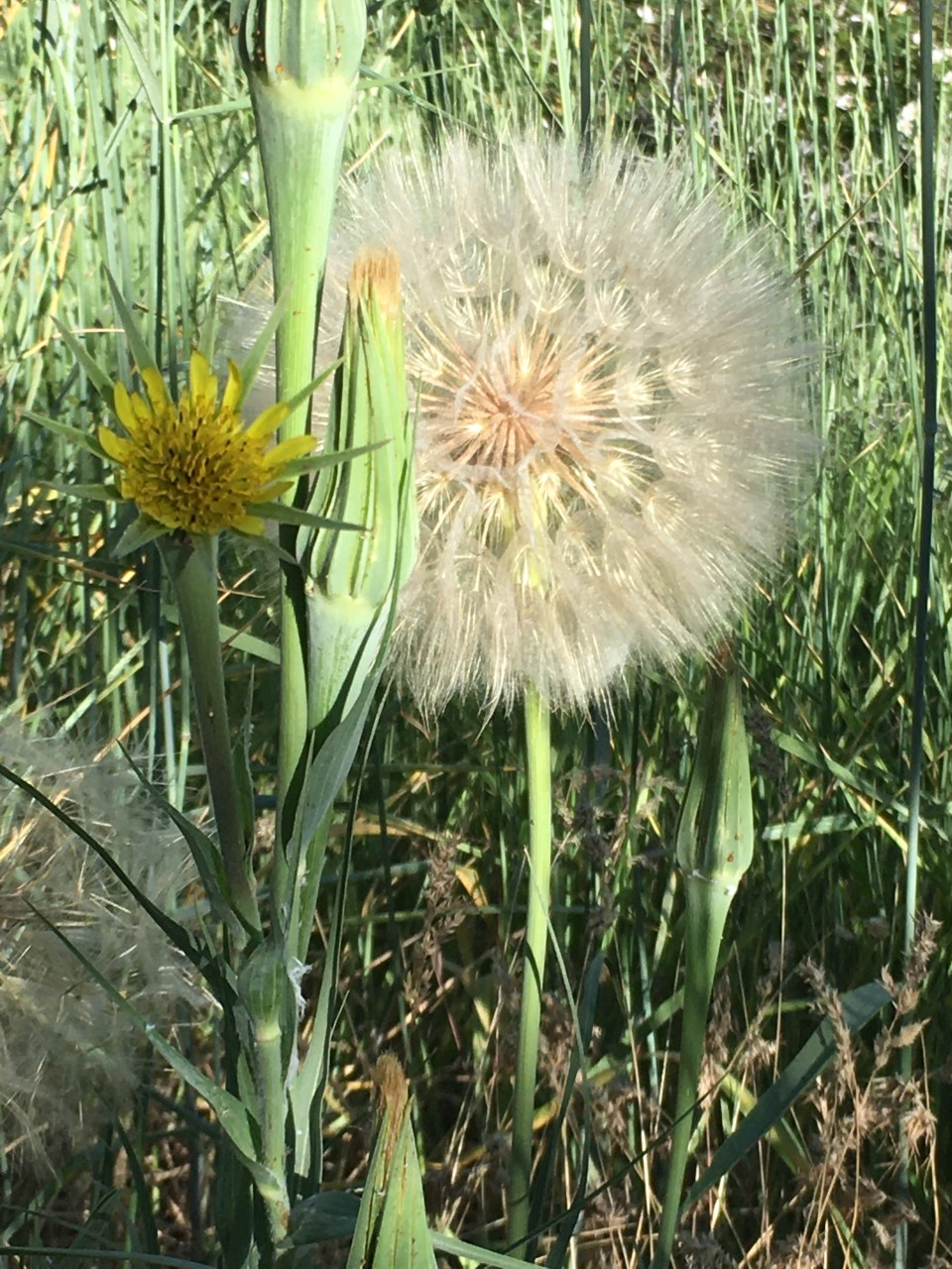
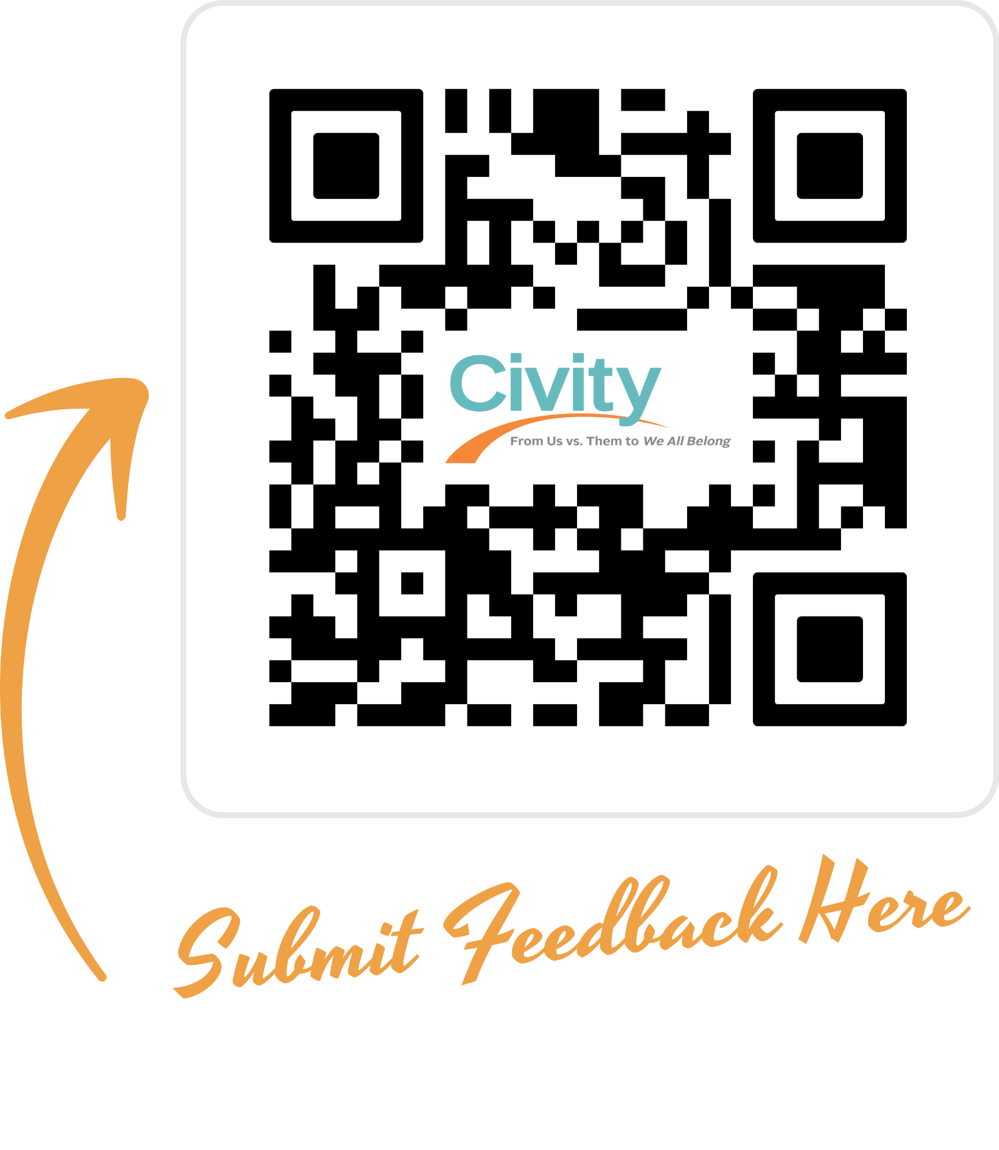
Lucy Hancock lucy@civity.org

