Slide 1
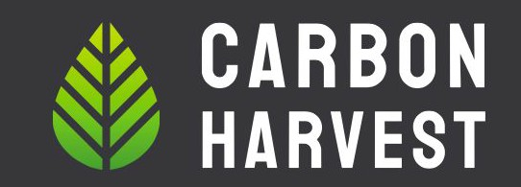
THE CINCINNATI BIOCHAR PROJECT

Slide 2
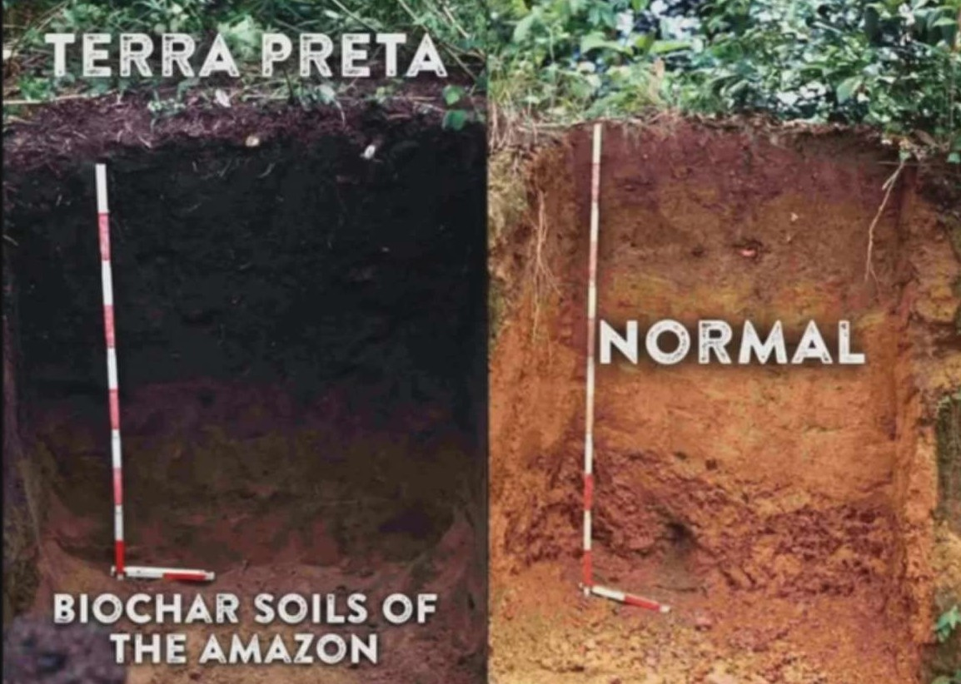
Tropical rainforest soils are typically low in fertility
Terra preta is still fertile to this day and is even mined for export

Slide 3
How Biochar is Made- Pyrolysis

Slide 4
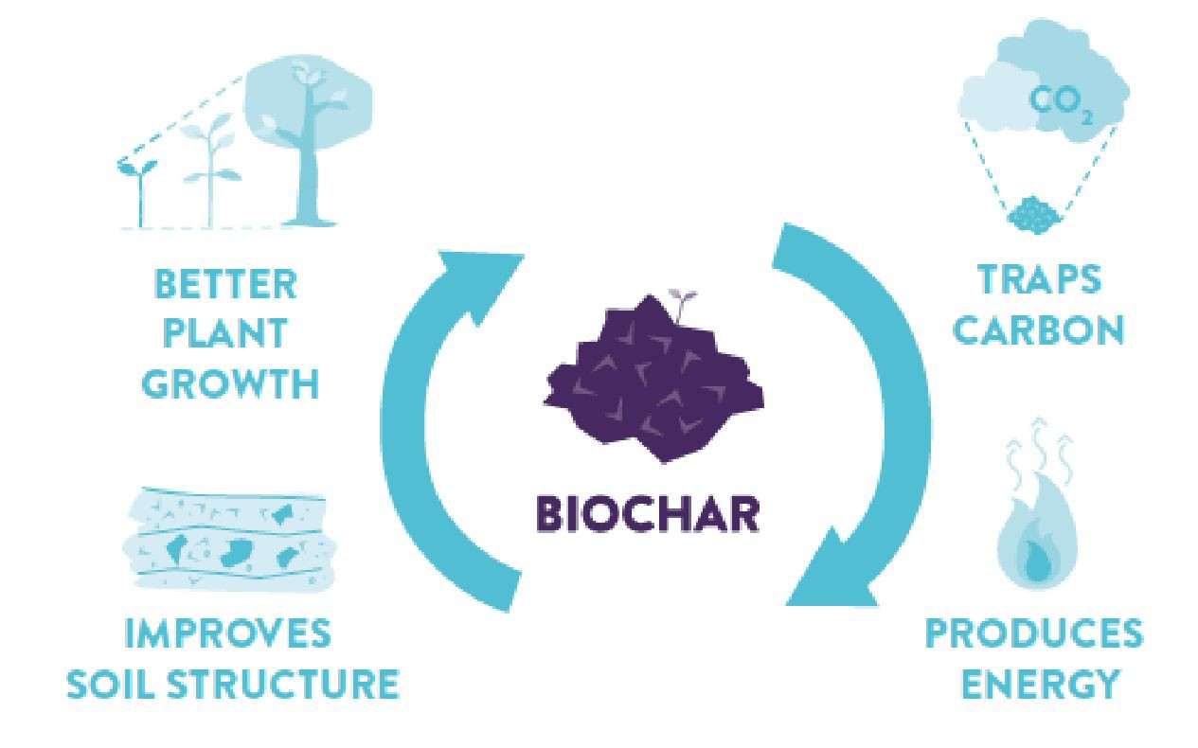
Featured by Project Drawdown as a carbon removal and sequestration technology

Slide 5
Effects of Adding Biochar to the Soil (Generally speaking)
Improves soil structure
Improves water holding capacity
Improves nutrient retention
Decreases nutrient leaching and runoff
Mitigates against contamination sources
Provides habitat for beneficial microbes
Increases soil organic carbon accumulation and can induce a negative priming effect
→ Healthier, more resilient plants and landscapes that further enhance climate benefits

Slide 6
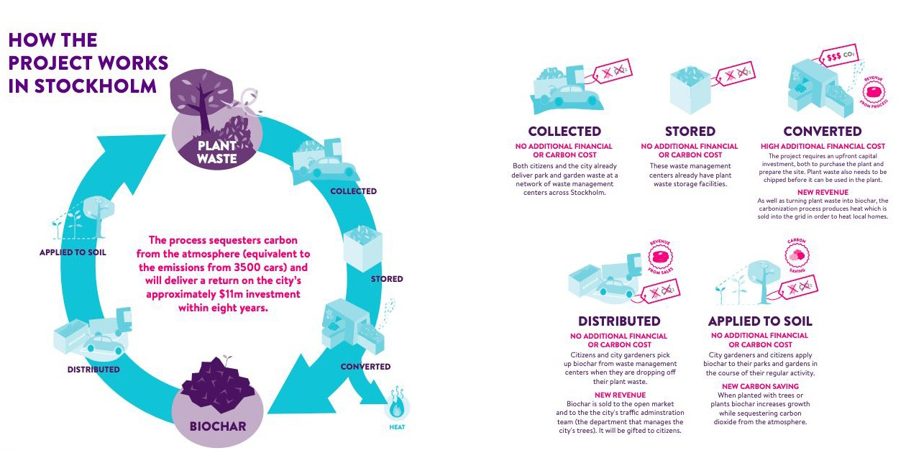
Stockholm Biochar Project

Slide 7
Specific Uses of Biochar in Stockholm
Tree cells in tight urban sites
Tree planting in field/open soil conditions
Amending planting beds
Stormwater infiltration
Urban gardens

Slide 8
Replicating the Stockholm Project Here
Bloomberg Philanthropies was a supporter of the Stockholm Biochar Project
They want to see it replicated → RFP for city-wide biochar projects
Cincinnati selected as 1 of 10 cities in the world to participate
Technical assistance
Qualified to apply for matching financial support from Bloomberg
Raised funds from Cincinnati Park Board and MSD

Slide 10
The Cincinnati Vision
Use biochar as a tool for meeting the goals of the Green Cincinnati Plan
Urban canopy (especially in low-income neighborhoods)
Emissions reduction
Stormwater management
Green infrastructure
Local food production, urban gardens
Climate resilience

Slide 11
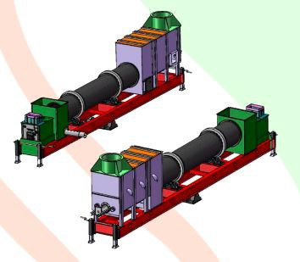
1
2
3
INPUTS
PRODUCTION
USES
Wood chips from Parks Dept and tree companies
Biochar Production
City Use
External Sales
Sidebar production opportunities
Utilizing heat
Generating electricity
Capturing syngas, wood vinegar

Slide 12
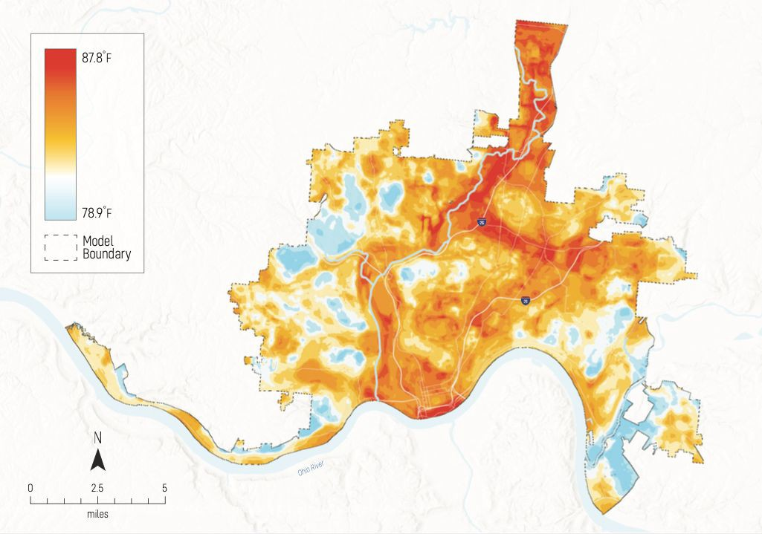

Slide 13
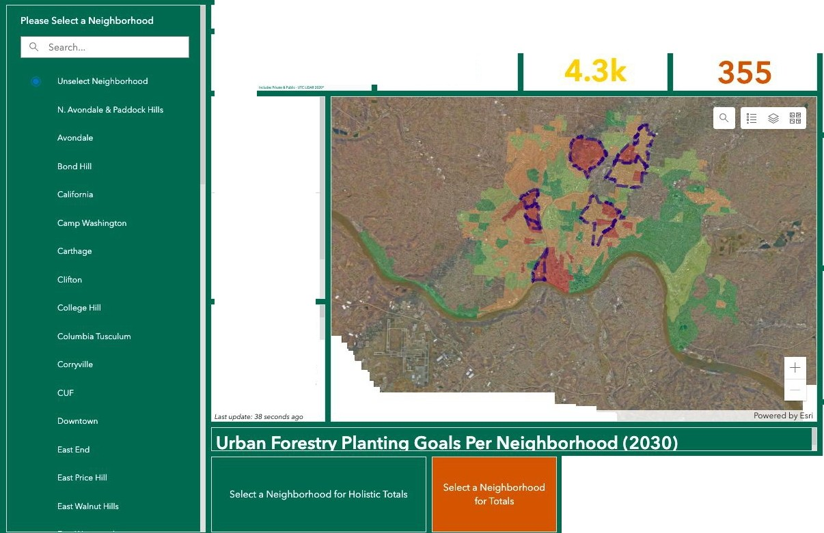
Cincinnati Tree Inventory, Canopy Stats, and Reforestation Goals Totals (2020 - 2030)
Tree Canopy%
Total Estimated Trees Planned Sites
1.6M
Total StreetTrees Inventoried
50k
40 60
Priority Reforestation Neighborhoods
C.asr updare: 39 seconds ago
Impervious Surface%
40 60
Reforestation Need
Tree Planting Totali
> 174-285
>100-174
Last updare: 38 seconds ago
>71-100
Canopy Potential %
Neighborhood
40 60
Selection required on one or more elements
Lasr updare: 38 seconds ago
Pervious Surface%
40 60
Select a Neighborhood for Totals
Last update: 38 seconds ago

Slide 15
Invitation for Engagement
Looking to integrate this project with the regional tree planting and climate mitigation projects happening via Taking Root and OKI
Sign up for our email list
www.carbonharvestllc.com
Sign-up sheet at the back of the room
sam@carbonharvestllc.com

