Slide 1
Lexington’s sustainability
Bluegrass Greensource Sustainability Summit
Jada Walker Griggs, Sustainability Program Manager Senior
April 10, 2024

Slide 2
Empower Lexington: A Plan for a Resilient Community
Sustainability
Stakeholders developed over a 3 year period (2009- 2012) – facilitated by LFUCG; supported by Council in 2012
Focus was on energy efficiency in 5 sectors:
1) Residential
2) Industrial, Commercial, Institutional
3) Land Use, Food, and Agriculture
4) Transportation
5) Waste
Plan was flexible / voluntary, with goal to reduce energy use by at least 1% year

Slide 3
Empower Lexington Plan Update 2023
Sustainability
New Sectors: Over 50 members; aligns with LEED for Cities Certification. Work to increase sustainability and climate resiliency.
Core Team (members from previous plan efforts)
Sectors:
Natural Systems and Ecology
Transportation and Land Use
Water Efficiency
Energy and Greenhouse Gas Emissions
Materials and Resources
Quality of Life (Justice, Equity, Diversity and Inclusion)
Engagement (public input) opportunities July-August

Slide 4
LEED for Cities
Sustainability
Lexington was selected as 1 of 13 cities to participate in the Leadership Cohort Program sponsored by the U.S. Green Building Council (USGBC) (Colorado Springs, CO; Des Moines, IA; Grand Junction, CO; Lantana, FL; Largo, FL; Lawrence, KS; North Miami, FL; Palm Coast, FL; Plano, TX; San Diego, CA; Scottsdale, AZ; South Bend, IN)
USGBC is the global leader in green building. Vision is that buildings and communities will regenerate and sustain the health and vitality of all life.
Program Objective: Obtain LEED* for Cities Certification
Program provides peer-to-peer networking opportunities, technical assistance, and access to educational resources; and covers fees for USGBC membership, registration, and certification review.
*LEED = Leadership in Energy and Environmental Design

Slide 5
Greenhouse Gas Emissions Inventory
Sustainability
Reactivate our community-wide greenhouse gas (GHG) emissions inventory
Track community-wide & LFUCG GHG emissions
RFP & Consultant selection completed in May
Establish baseline using 2021 emissions
Recommend GHG reduction targets
Set GHG emissions reduction targets
Programs, policies, projects, and initiatives to help us reach our targets
Re-calculate GHG emissions every 2 years going forward

Slide 6
Solarize Lexington Program
Sustainability
Partnered with KY Solar Energy Society for a second year to provide a vetted process for residents
Group buying program designed to promote and encourage the use of solar
Open only to Lexington-Fayette County residents, small businesses, non-profits, and places of worship
Council approved $1 Million for grants to low-to moderate-income homeowners < 80% Area Median Income.
Launched on March 12; Enrollment ends Aug. 9th

Slide 7
Solarize Lexington Program
Sustainability
2023
- 634 Interest Forms Submitted
- 76 Signed Contracts
(42 grant-34 non-grants)
- 560kW installed leading to an energy savings
for the year of 672,000 kWHrs
42 grant-approved contracts signed (average cost per home = $21,545)
“THANK YOU - THANK YOU - THANK YOU. My system is up and running. Wow it is really fantastic. What a wonderful over all experience from beginning to end.” - Solarize Lexington Grant Recipient

Slide 8
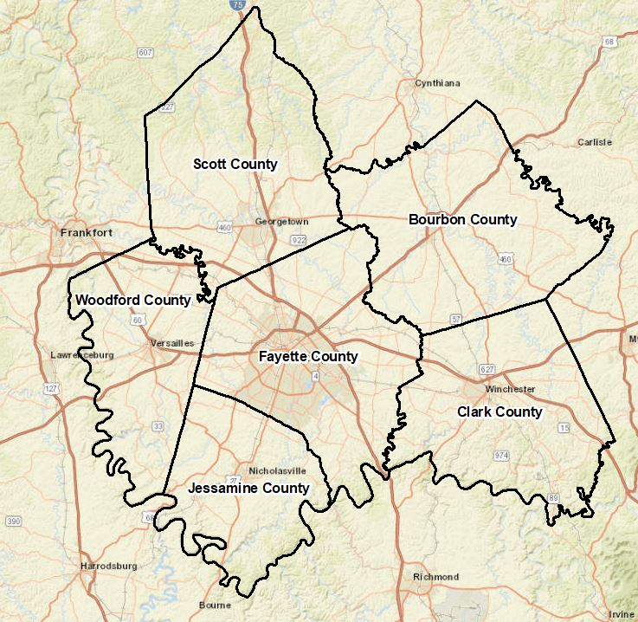
Climate Pollution Reduction Planning
Sustainability
Lexington-Fayette County Metropolitan Statistical Area (MSA) received just under $1 million dollar for a planning grant from U.S. Environmental Protection Agency to develop a Priority and Comprehensive Climate Action Plan
Planning for reducing GHG emissions and other harmful air pollution

Slide 9
Priority Climate Action Plan (PCAP)
Sustainability
Requirements:
Simplified GHG Inventory for MSA
List of “Implementation Ready” Measures
Quantified GHG Reductions
Review of Authority to Implement
Low Income/Disadvantaged Communities Benefits Analysis
Stakeholder Engagement
Implementation Grant
Provide funds for greenhouse gas (GHG) reduction measures that will significantly reduce cumulative GHG emissions by 2030 and beyond, and
Will accelerate decarbonization across one or more major sectors responsible for GHG emissions.

Slide 10
Implementation Measures
Priority Climate Action Plan
Tree Canopy
Increase tree canopy in our MSA
Solarize Lexington Program
Extend the program to homeowners in other counties in our MSA
Weatherization Program
Homeowners and renters with low- to moderate- income
Lextran Electric Bus Charging Canopy Project
Provide cover/weather protection for electric fleet, charging infrastructure for each parking stall and generator backup for recharging during power outages
Regional Electric Vehicle Charging Study
Identify demand for future public electric vehicle recharging stations

Slide 11
Comprehensive Climate Action Plan (CCAP)
Sustainability
Requirements:
Build on the simplified emissions inventory conducted for the PCAP to complete a comprehensive GHG Inventory for the CCAP
Quantify Comprehensive GHG Reductions Targets by Sector
Benefits Analysis
Low Income/Disadvantaged Communities Benefits Analysis
Stakeholder Engagement
Review of Authority to Implement
Intersection with other funding opportunities

Slide 12
Questions? jgriggs@lexingtonky.gov www.lexingtonky.gov/sustainability
Sustainability

