Slide 1
Oliver Kroner | Director, City of Cincinnati Office of Environment & Sustainability

Slide 2
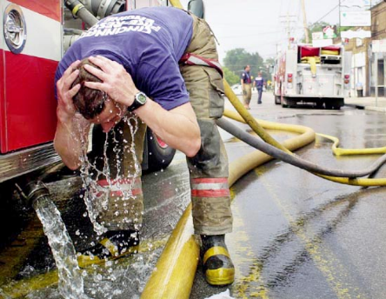
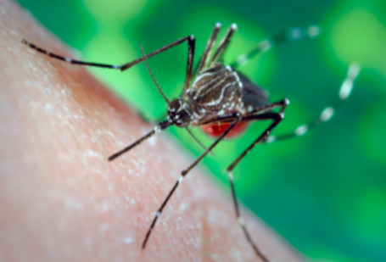
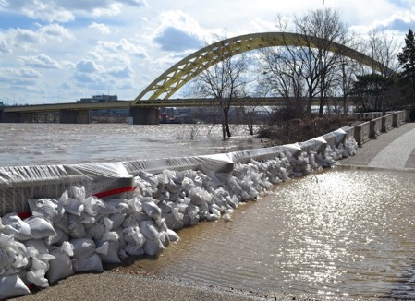
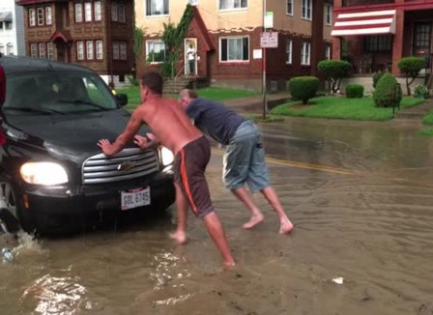
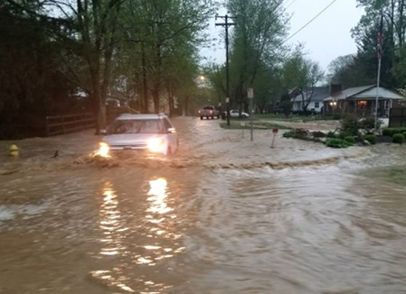
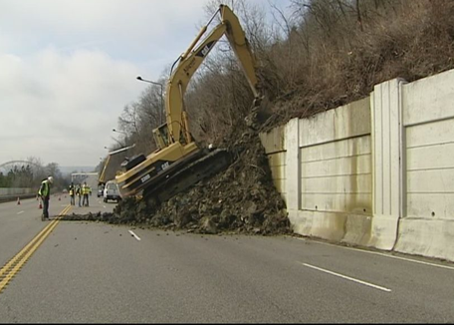
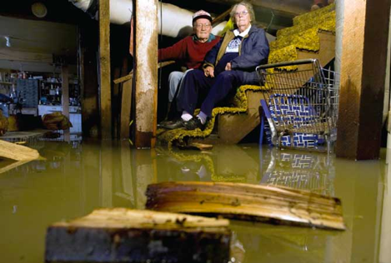
CLIMATE CHANGE IN CINCINNATI
HEAT
PESTS
HEALTH
STORMS
LANDSLIDES
SEWER BACKUPS

Slide 3
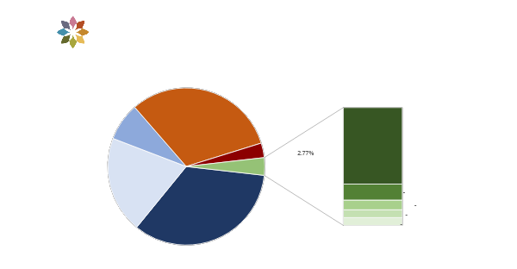
Cincinnati Carbon Profile
5.9M metric tons of carbon emitted in Cincinnati in 2021

Slide 4
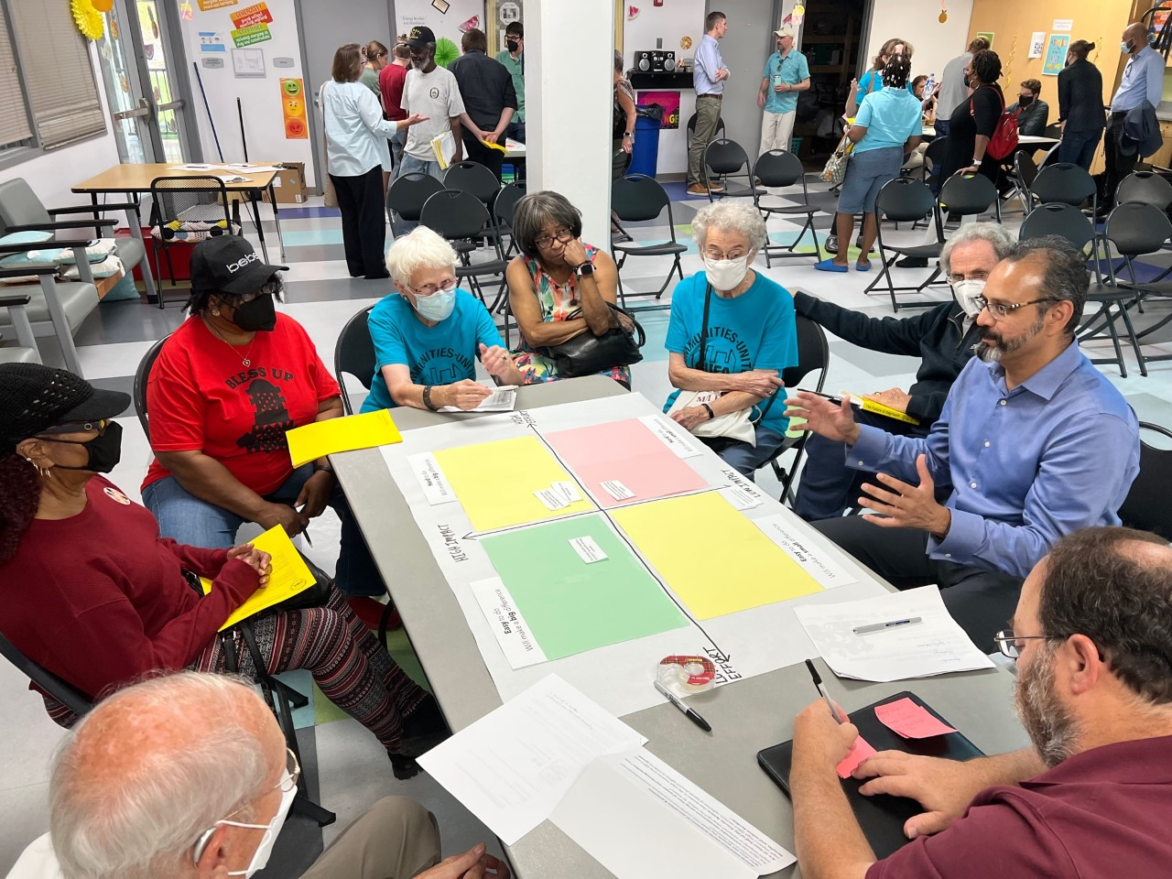
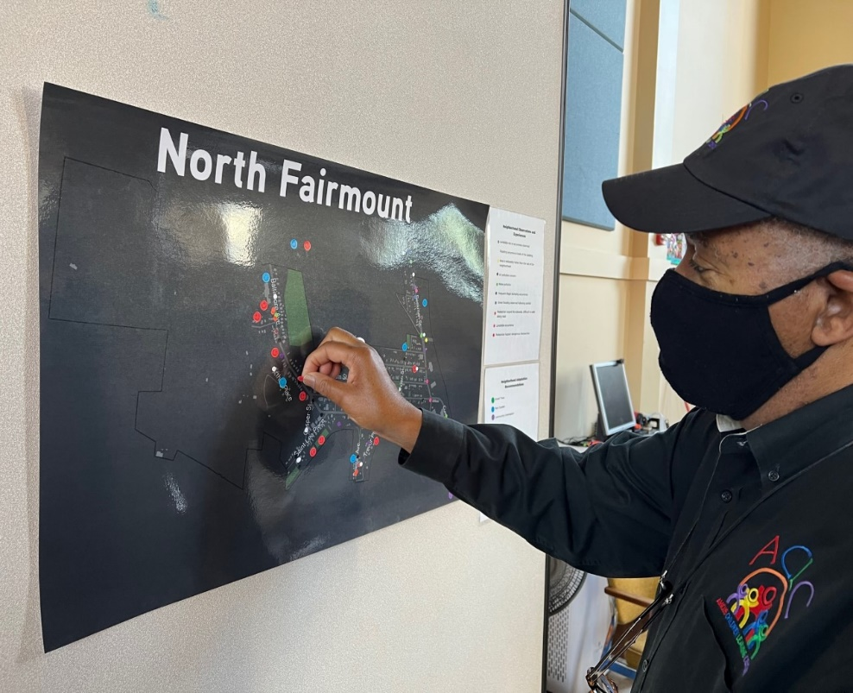
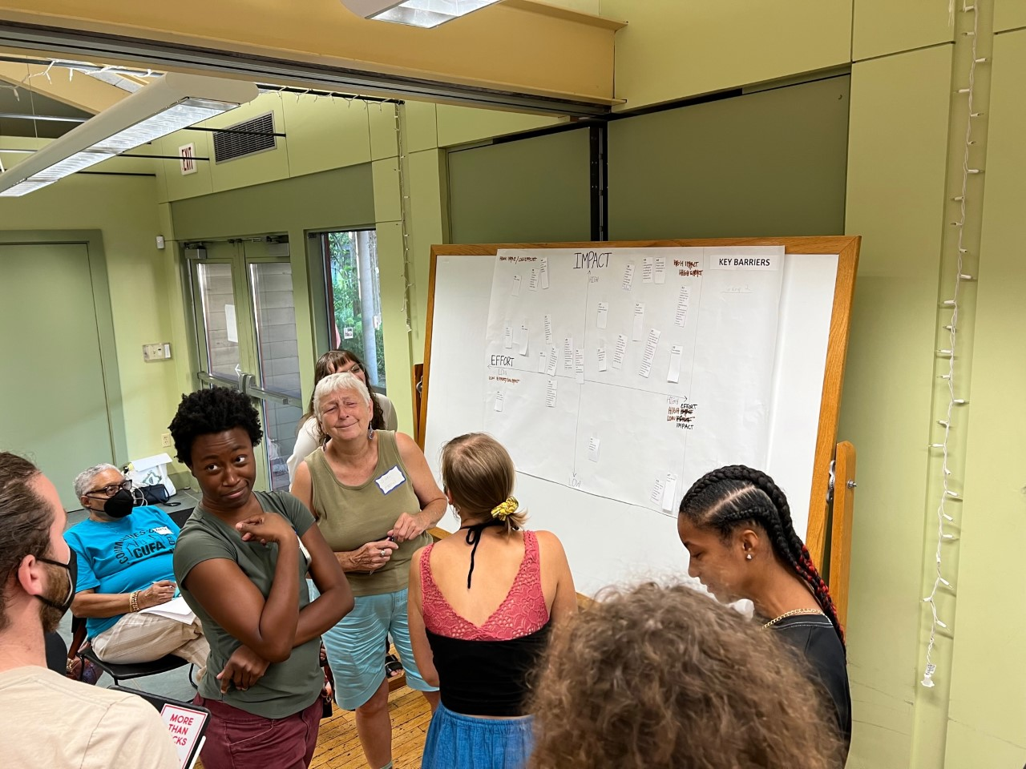
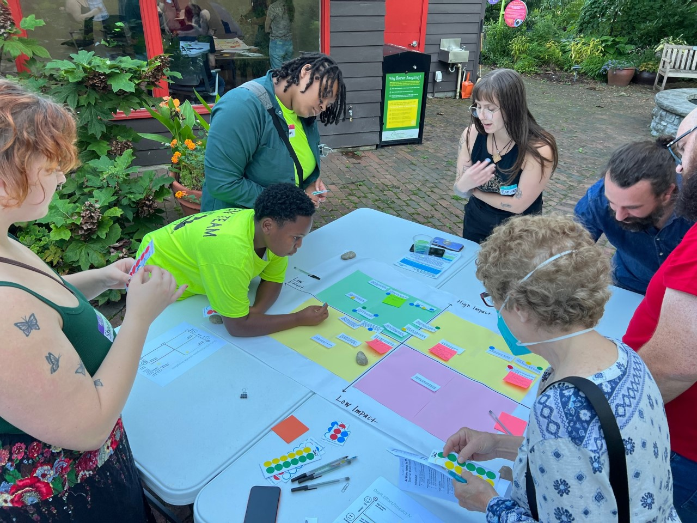
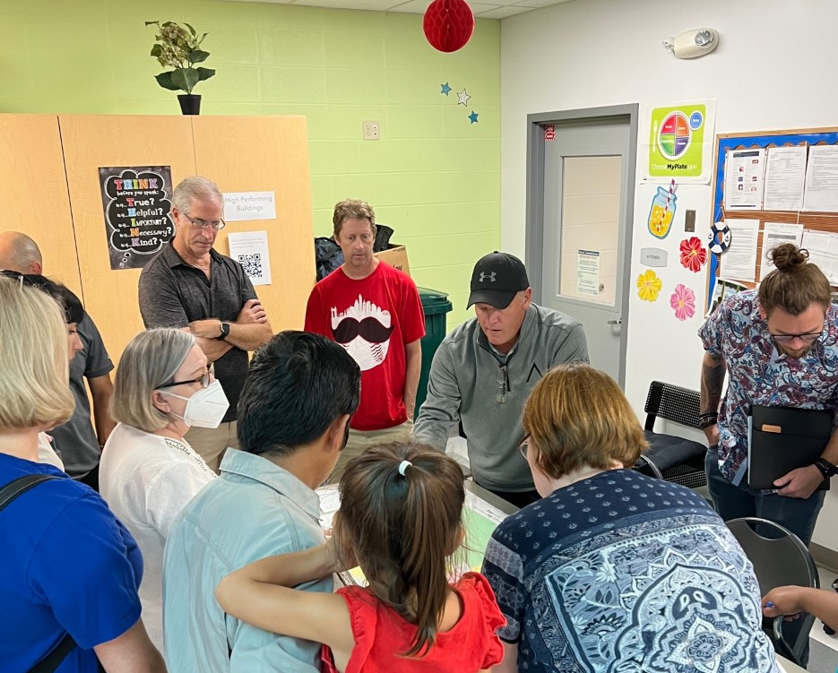
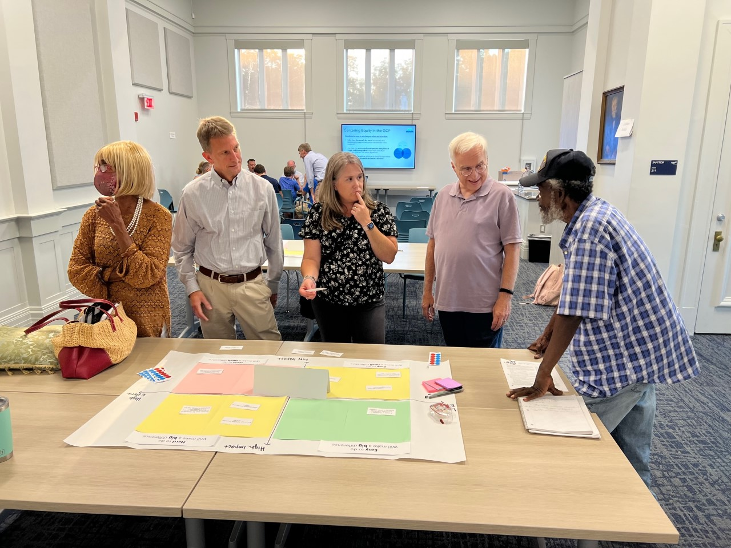
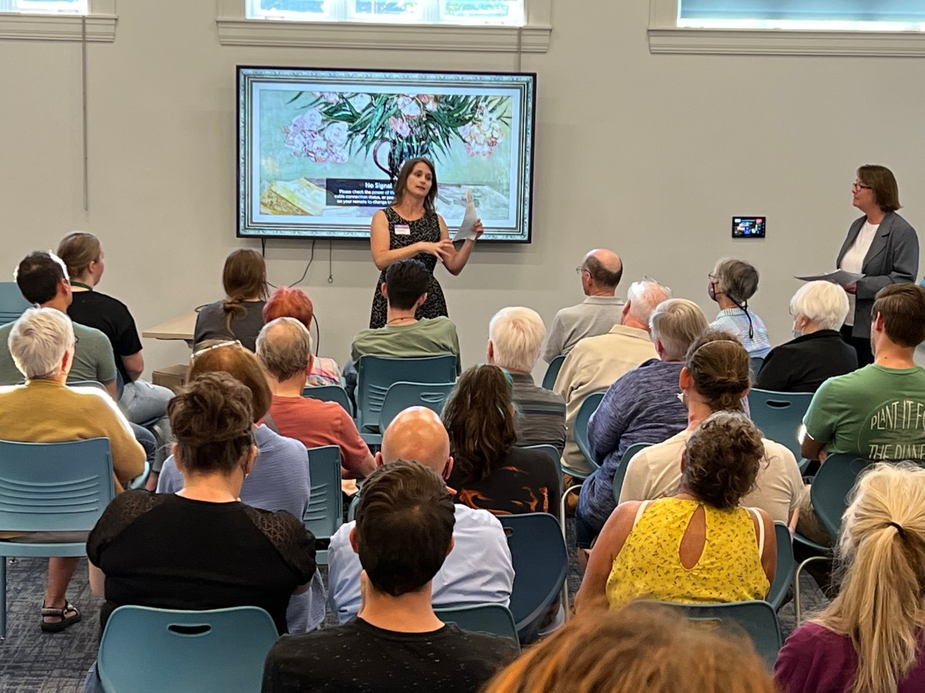
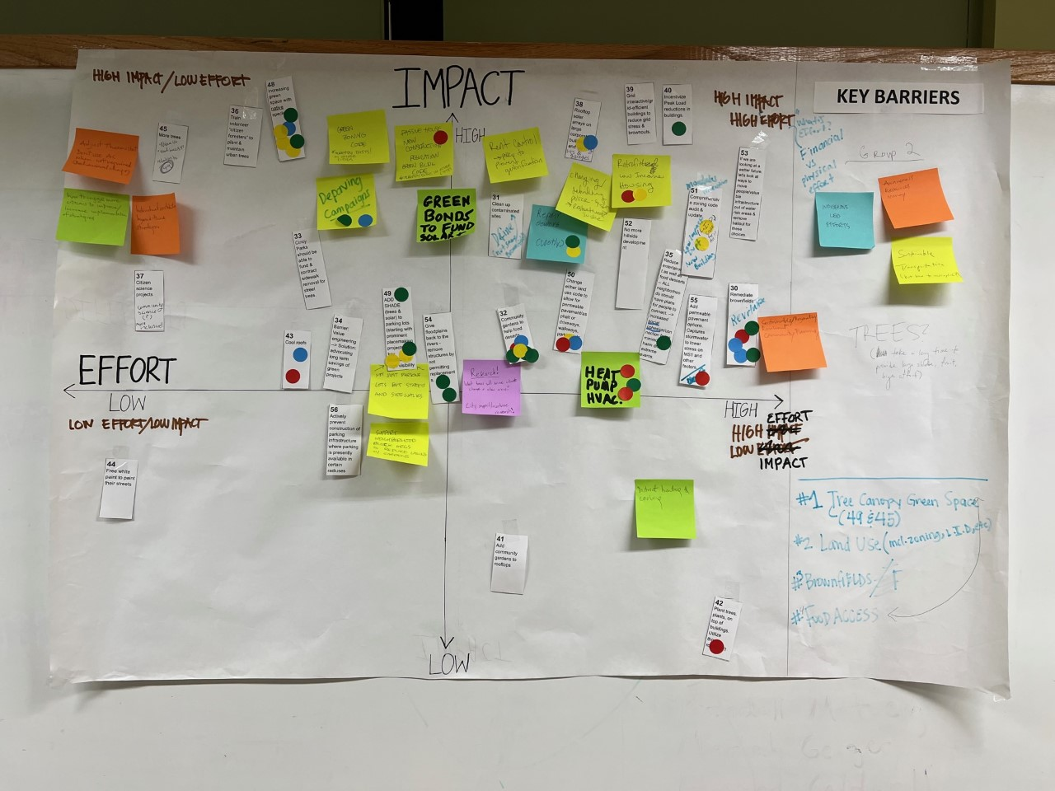
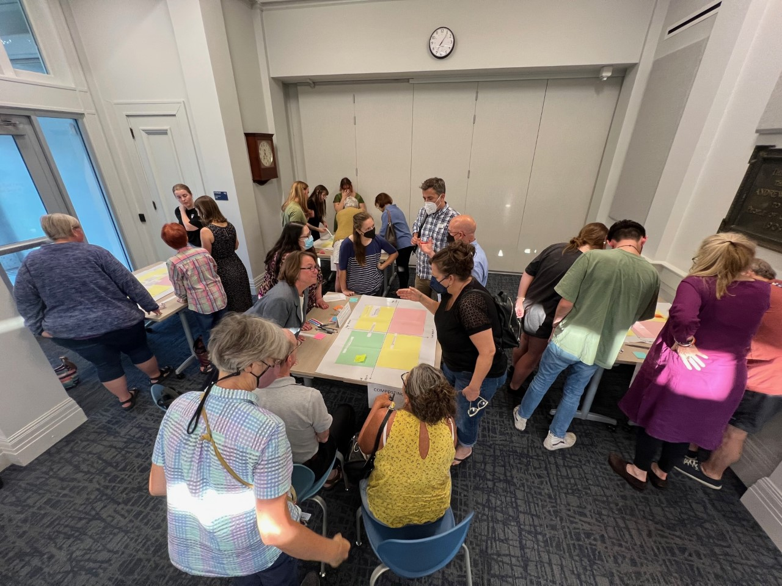
42
Public meetings/
engagements 1,680+ Planning session attendees
175+
Priority community members compensated for their engagement
3,000+
Recommendations Received
1,000+
Survey Responses
600+ Public Comments

Slide 5
Climate Safe Neighborhoods Equitable Community Engagement
6-week workshops with citizens who are paid to offer their community expertise on climate change impacts in their neighborhood
Build relationships and trust and a better understanding of how to work together
Empower community to take advantage of government and community programs
Inspire and train climate advocates

Slide 6
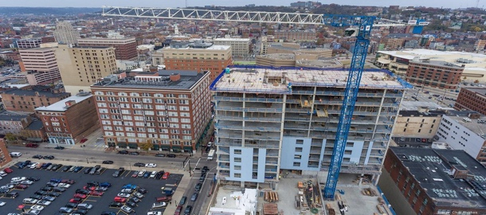
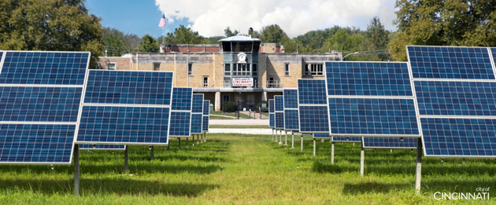
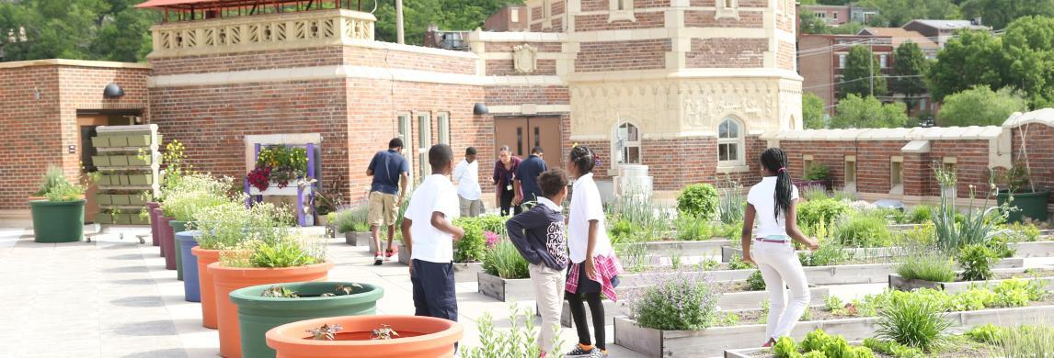
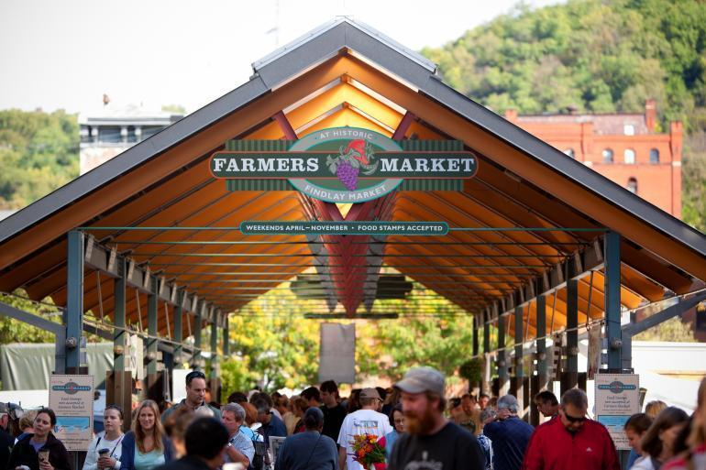
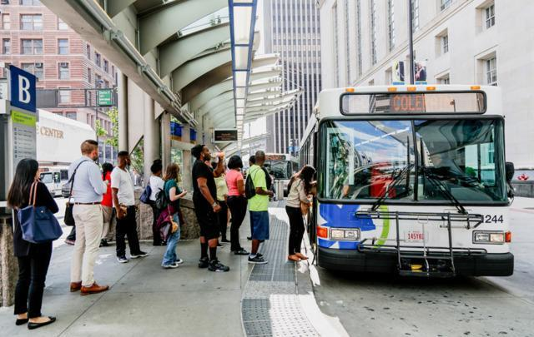
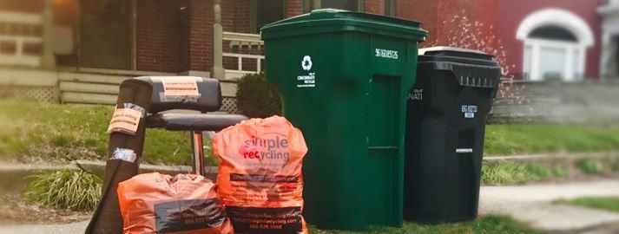
NATURAL SYSTEMS
GREEN CINCINNATI PLAN
BUILDINGS & ENERGY
CITY OPERATIONS
COMMUNITY ACTIVATION
FOOD
MOBILITY
RESILIENCE & ADAPTATION
ZERO WASTE
50% carbon emissions reduction by 2030, 100% carbon neutral by 2050.
Sustainability. Equity. Resilience.

Slide 7
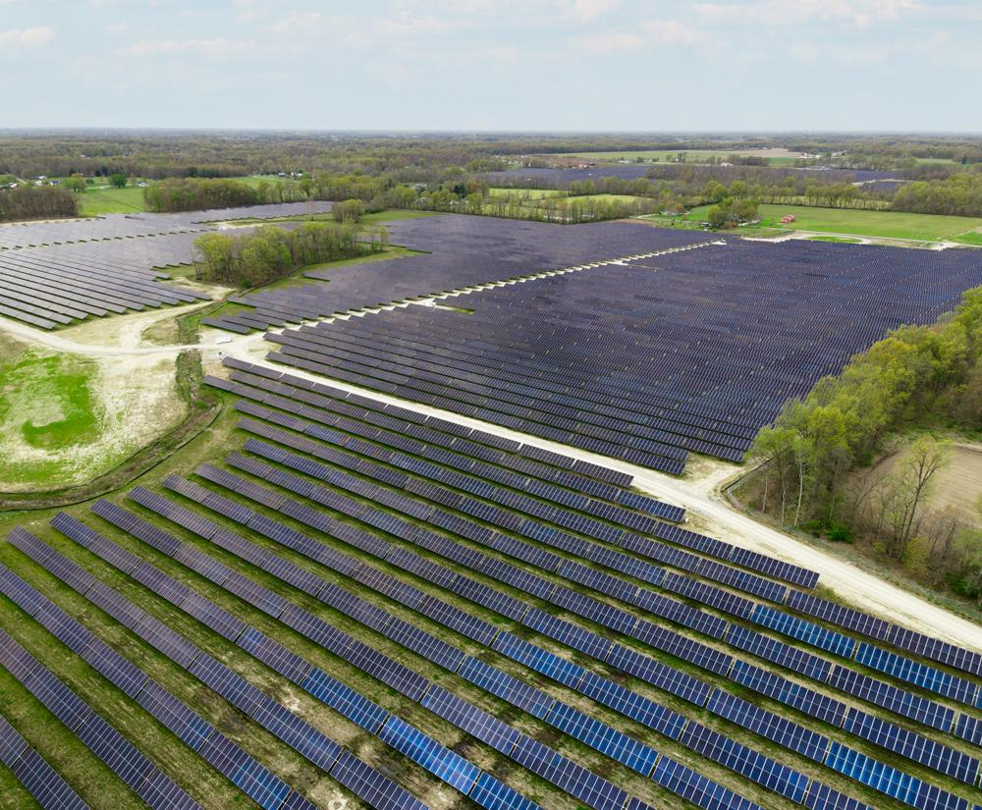
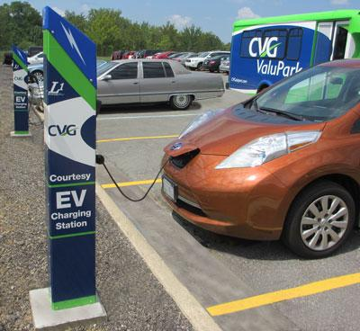
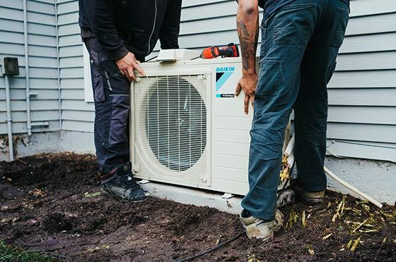
100% Clean Energy + Electrification
Utility scale renewable energy
Electric Vehicles & Charging Infrastructure
Electrified buildings
Heat pumps (& Building Envelope!)
Electric & Induction cooktops
Hot water heaters

Slide 8
100% Green Energy for the City
100 Megawatt solar farm under construction (Power Purchase Agreement)
Energy Aggregation Program - Green energy delivered to ~80,000 homes and biz
~10% savings from conventional utility rate
Workforce development program to grow solar sector employment

Slide 10
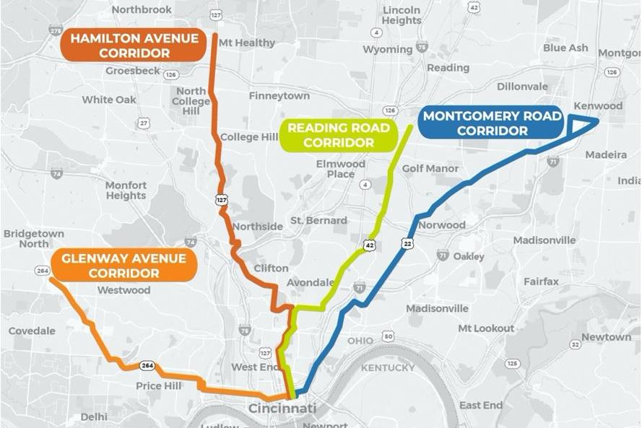
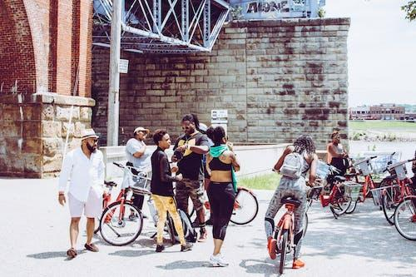
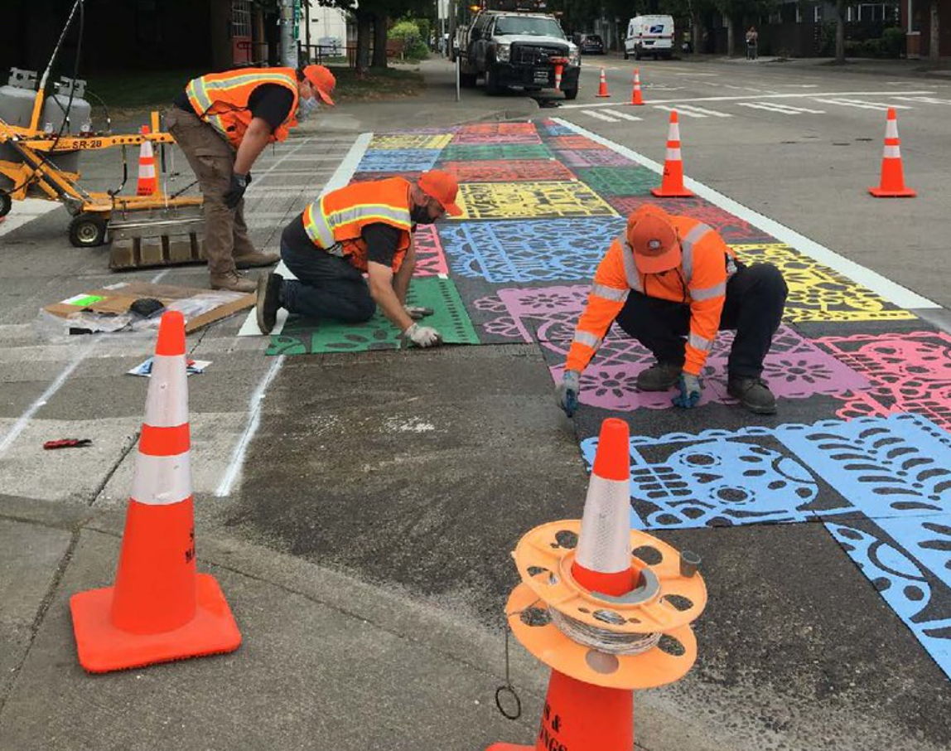
Connected Communities
Walkability
Bikability
Density
Focus on transit corridors

Slide 11
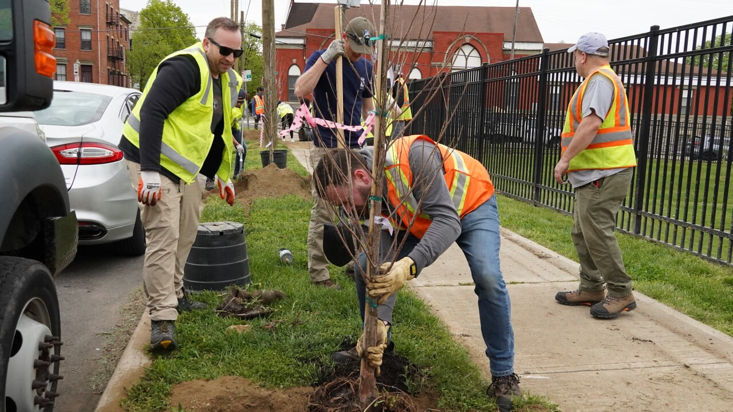
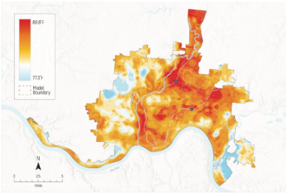
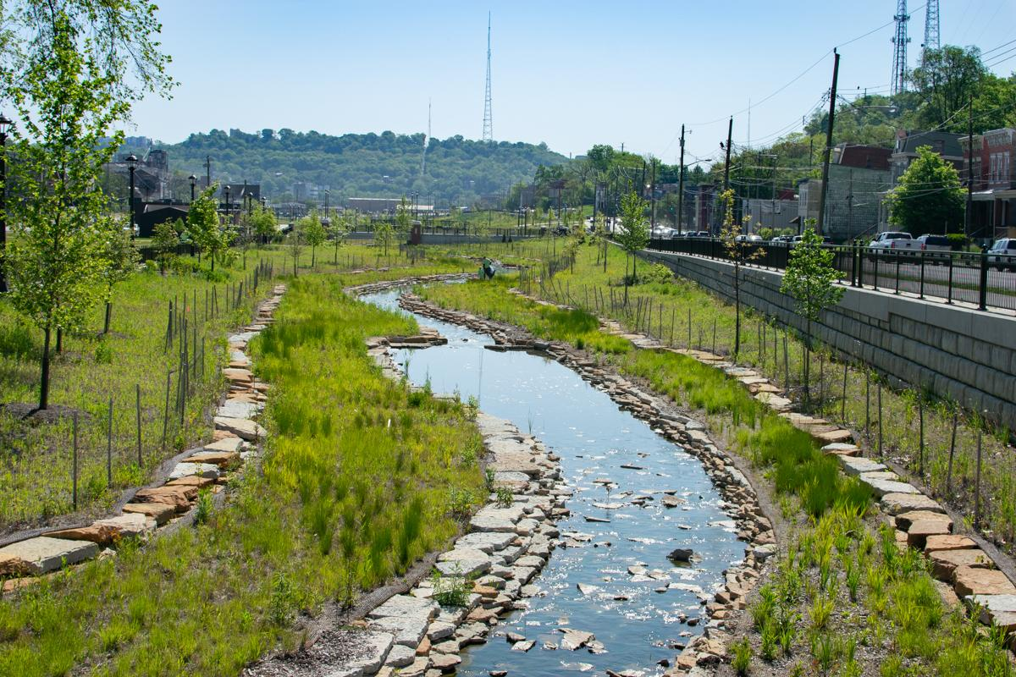
Green Infrastructure & Resilience
Expand use of greenspace to soak up stormwater and reduce heat
Improve urban tree canopy, specifically in residential communities <30%
Protect landslide-prone hillsides and overland flood risk zones through land development policies

Slide 12
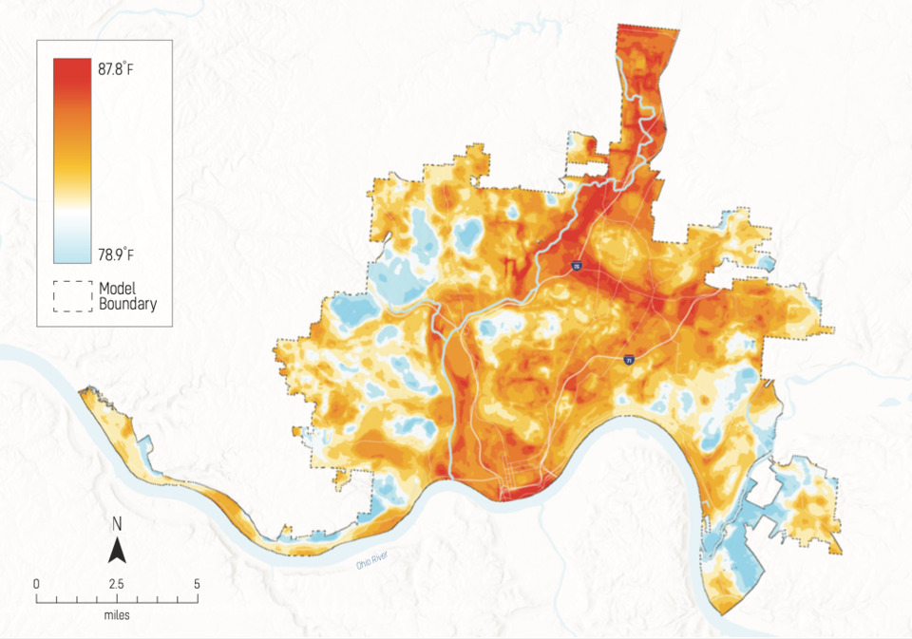
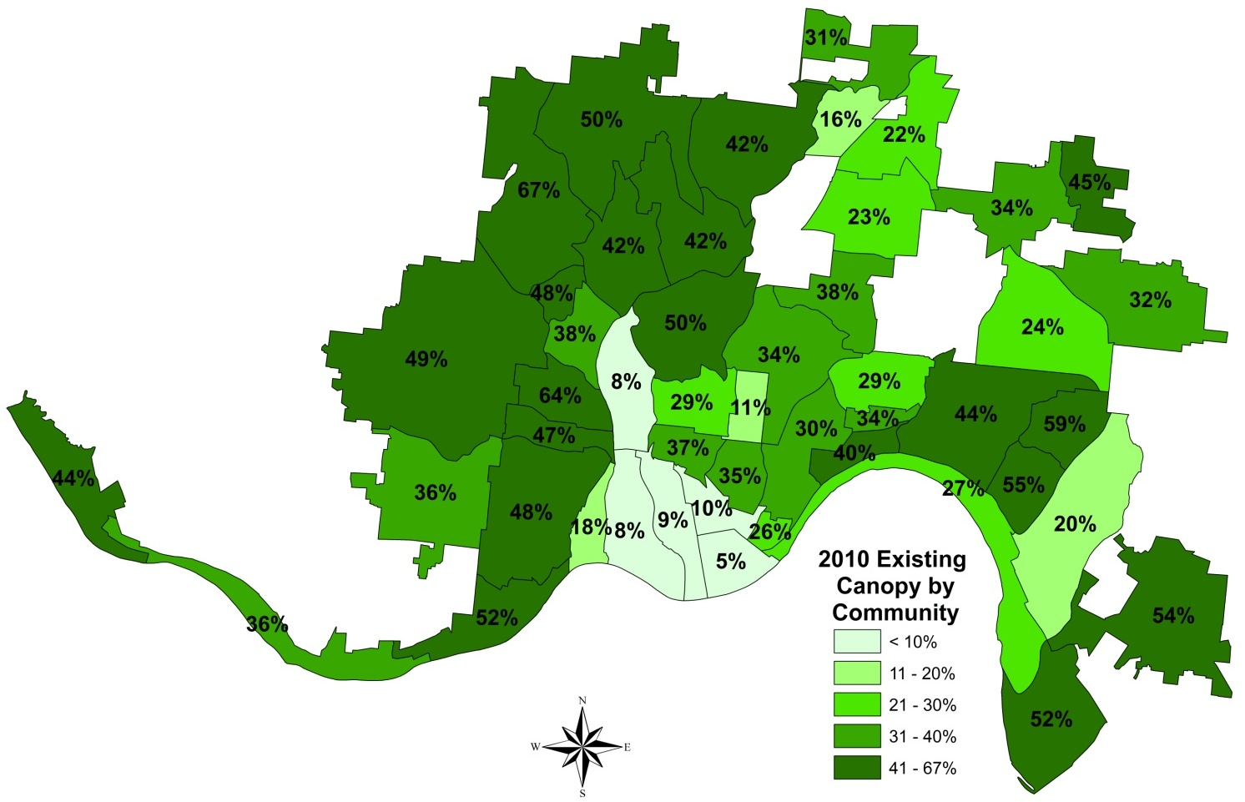
Tree Canopy
Improve Tree Canopy
Heat Map

Slide 14
GreenCincinnatiPlan.org

Slide 15
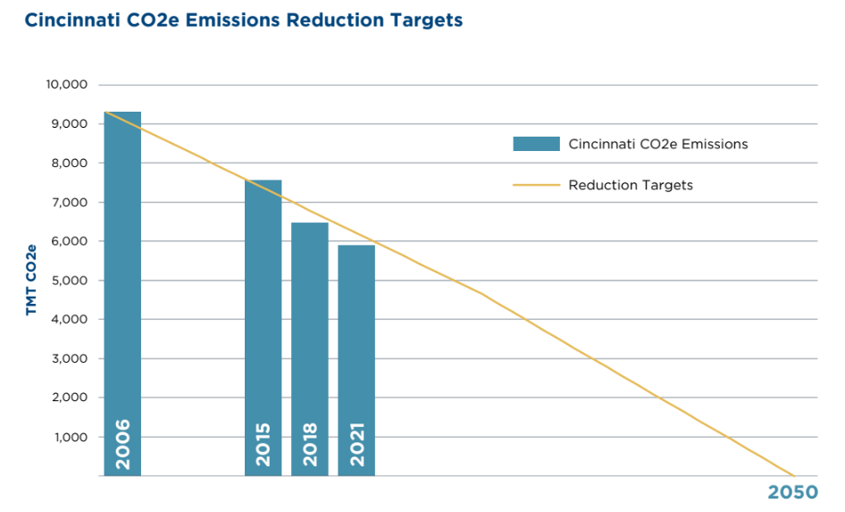
It’s working!
-38.6%
Reduction in Cincinnati emissions since 2006

Slide 16
Total Cincinnati MSA Application: $180M
Low-income energy efficiency: $23M
Renewable energy on public and non-profit buildings: $48M
Transit improvements and incentives: $67M
Industrial Decarbonization: $25M
Food and Organic waste diversion: $15M
Tree planting: $2.5M

Slide 17
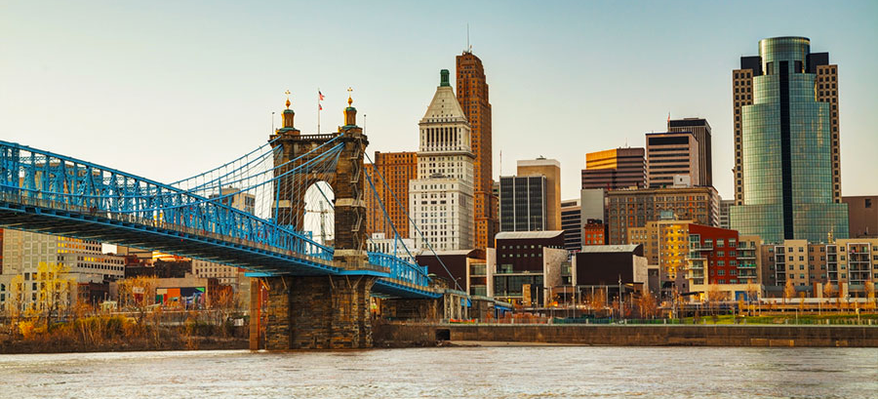
Need your help:
GreenCincinnatiPlan.org
oliver.kroner@cincinnati-oh.gov

