Slide 1
From Campus to Community
Voices for a Sustainable Future

Slide 2
Jack Bell
Air Justice project
UKY Environmental and Sustainability Studies
jabe295@uky.edu

Slide 3
01
Air Justice Project
Working towards sustainability for All

Slide 4
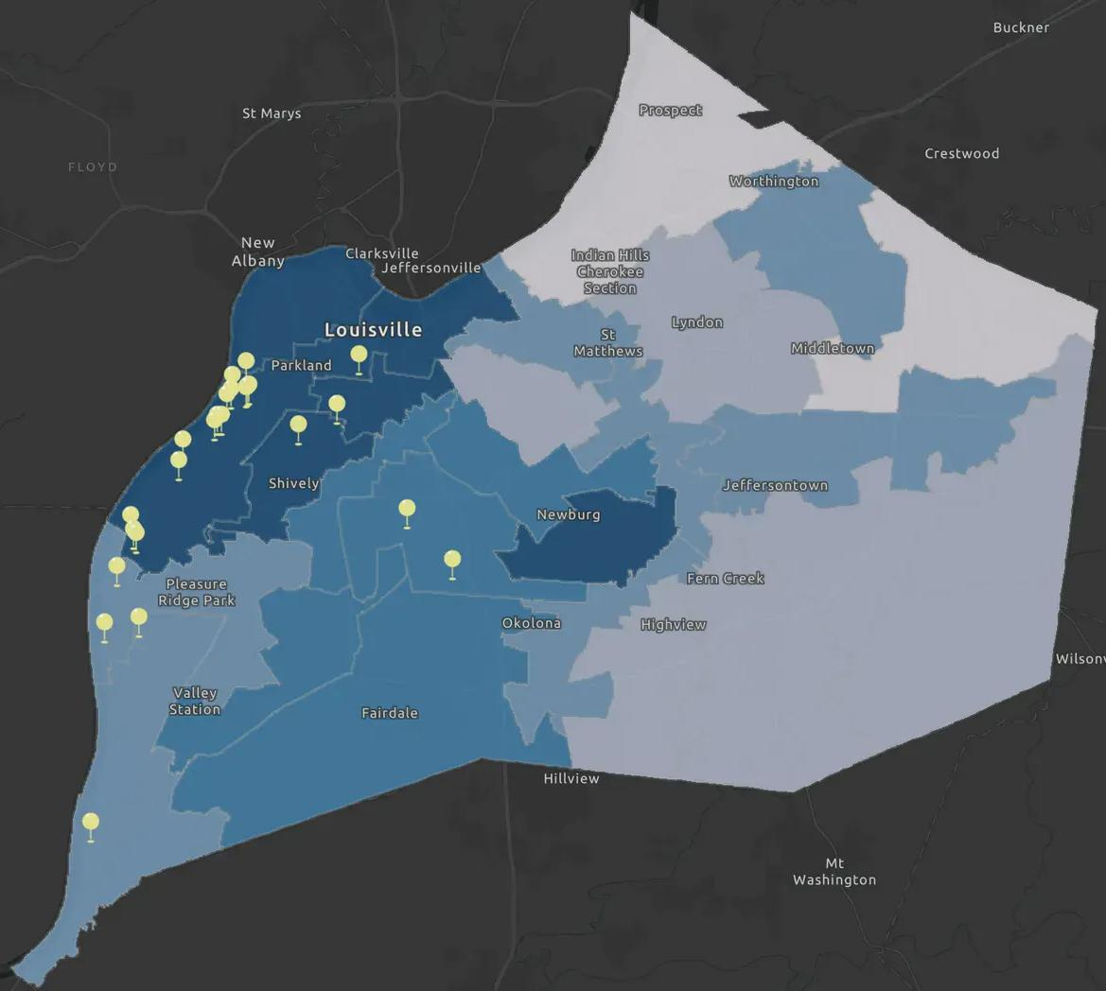
Rubbertown
&
the West End

Slide 5
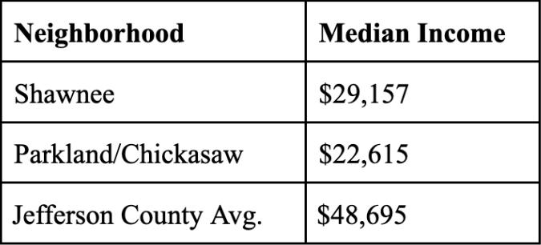
Income
and
Health
Indicator | State Percentile | US Percentile
Low Life Expectancy | 75 | 89
Heart Disease | 80 | 93
Asthma | 96 | 98
Persons with Disabilities | 52 | 80

Slide 6
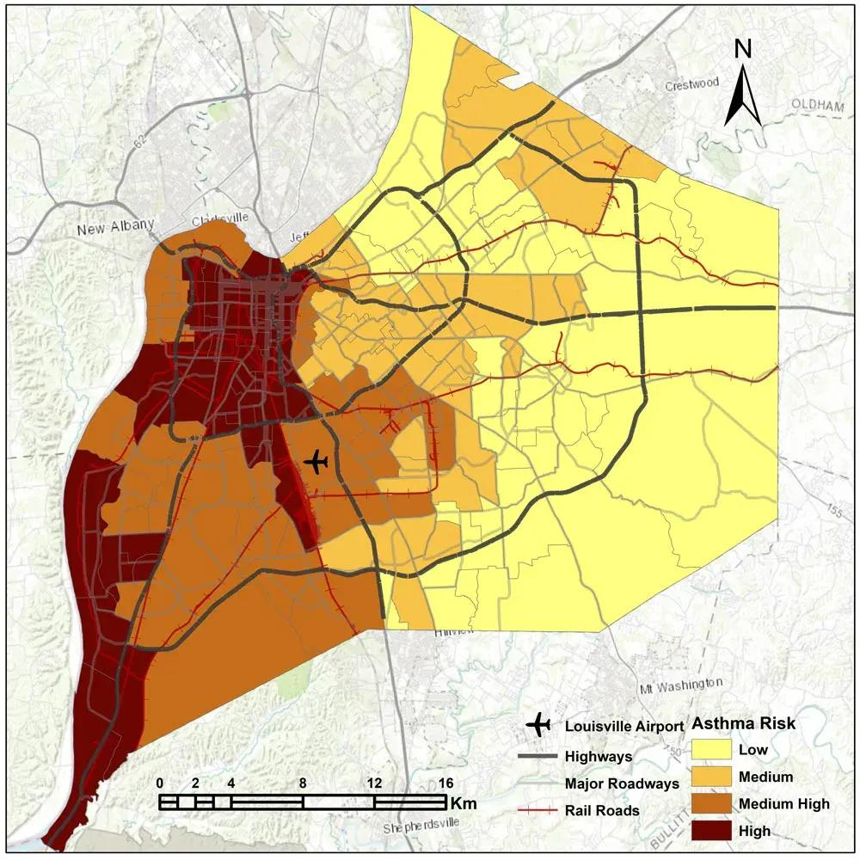
Rubbertown Asthma Risk

Slide 7
What is Air Justice?

Slide 8
Sustainability Frameworks
Traditional Sustainability
Community Sustainability
Often exclude low-income and disenfranchised communities. | The resilient efforts of disenfranchised communities.
Disparities in access to resources, representation, and participation in sustainability initiatives. | Communities create and maintain their own sustainable lifestyles.
Top down approach to sustainable strategies. | Incorporating communal knowledge and experience.
Exclude groups from decision making. | Including communities in decision making regarding sustainability and their health.

Slide 9
Barriers to Traditional Sustainability
Communities we often see as separate actually share similar challenges. This trend can help us further understand the limits to the traditional sustainability framework

Slide 10
Achieving Community Sustainability
Despite the numerous walls disenfranchised communities often face, they have a strong history of banding together and creating their own form of local sustainability to combat these barriers
This can include:
Establishing local/community based food systems
Cultural preservation and shared resilience
Environmental stewardship
Community and organizational activism/resistance

Slide 11
Connect with Air Justice
Website: https://www.airjusticelou.org/
Instagram: @airjusticelou
Facebook: Air Justice
YouTube: @airjusticelou
Personal Email: jabe295@uky.edu

Slide 12
Brittany Morton
AmeriCorps Member
Environmental Education Leadership Corps

Slide 13
What is AmeriCorps?
Independent agency of the United States government that engages more than five million Americans in service through a variety of stipended volunteer work programs in many sectors.

Slide 14
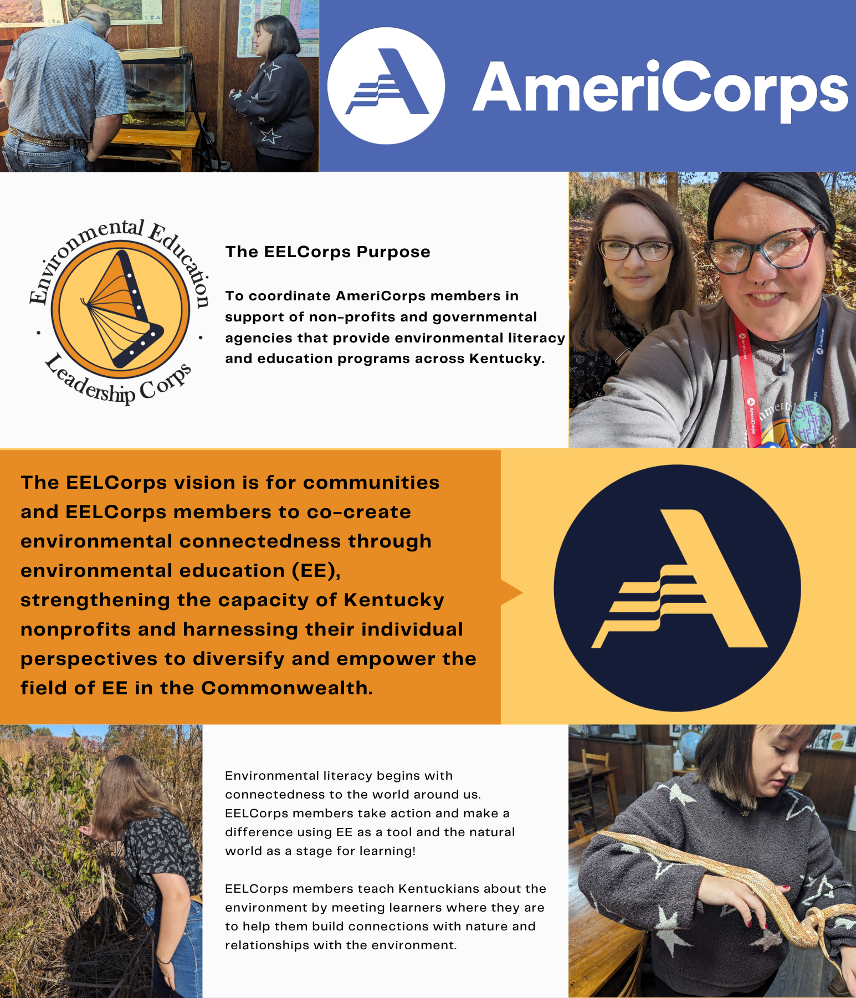
What is Environmental Education Leadership Corps ?
The mission is to increase environmental literacy across the commonwealth of Kentucky.

Slide 15
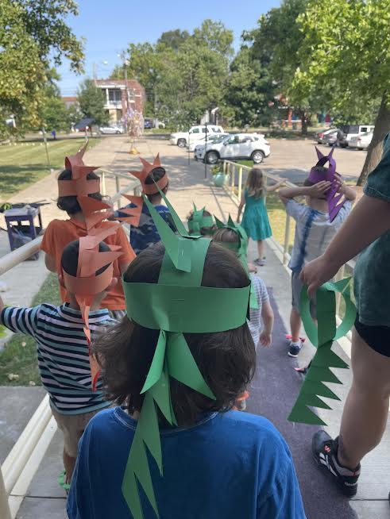
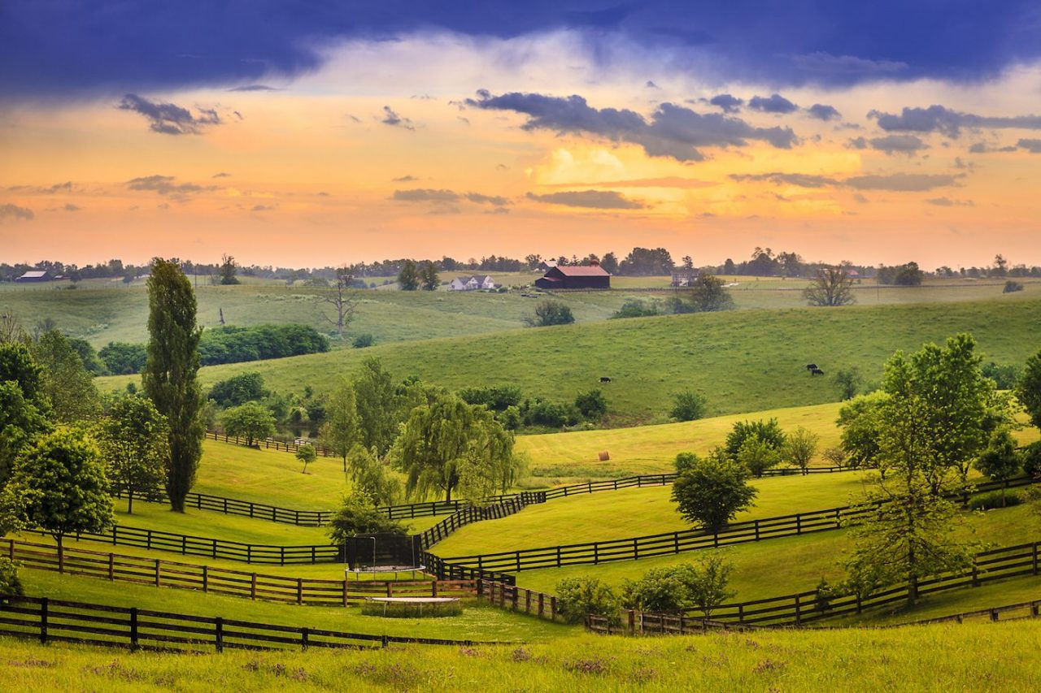
What did I join AmeriCorps?
I wanted to make a difference in my community and help Kentucky be stronger and healthier. I went into environmental education because I also have a passion protecting the environment. I want to make a positive impact by raising awareness and fostering a sense of responsibility for the planet.
I really enjoy working with students. I enjoy watching the spark happen as they learn a new way to conserve water in their homes (conservation matching game). I love when they can explain to other adults what a watershed is and how we need to clean up after ourselves.

Slide 16
First year of AmeriCorps
Pre-K Art Day
No-School Day Camps
Making Art projects with reusable/ recycle materials.
I was able to do a one day intensive of fun activities for students to do.
Field Trips
Summer Camps
Students were able to make projects to take home using reusable/ recycle materials.
This was an extension of the one day summer camps, and able to into depth with lessons.

Slide 17
Second year of AmeriCorps
Rise Stem Academy
Earth Week: Lexington Parks
I have been able to work with Rise in developing their composting system.
I will be teaching a lesson on Lexington Parks and what students look for.
Watershed Ecoscape
I was able to do a watershed activity with 6 different schools ranging from elementary to high school.

Slide 18
What will this do my future?
As a future educator, I want to think about the actions I take with teaching my students the information I have learned throughout my time in AmeriCorps. I want to be able to use recycled materials for building sets and prop pieces but als the way I conduct a classroom. In theatre, paper is used a lot for scripts and in classroom for drawing. I want to think about how do this differently to decrease the amount of paper I use.

Slide 19
Thank you!

