Slide 1
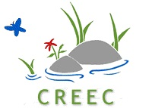
Bluegrass Greensource Sustainability Summit April 10, 2024

Slide 2
How did you form?
What are you doing?
Why and how do people stay engaged?
A couple of case studies.

Slide 3
How did you form ?

Slide 4
What are you doing ?

Slide 5
How do people stay engaged ?

Slide 6
Oh, by the way, where is Clarks Run ?

Slide 7
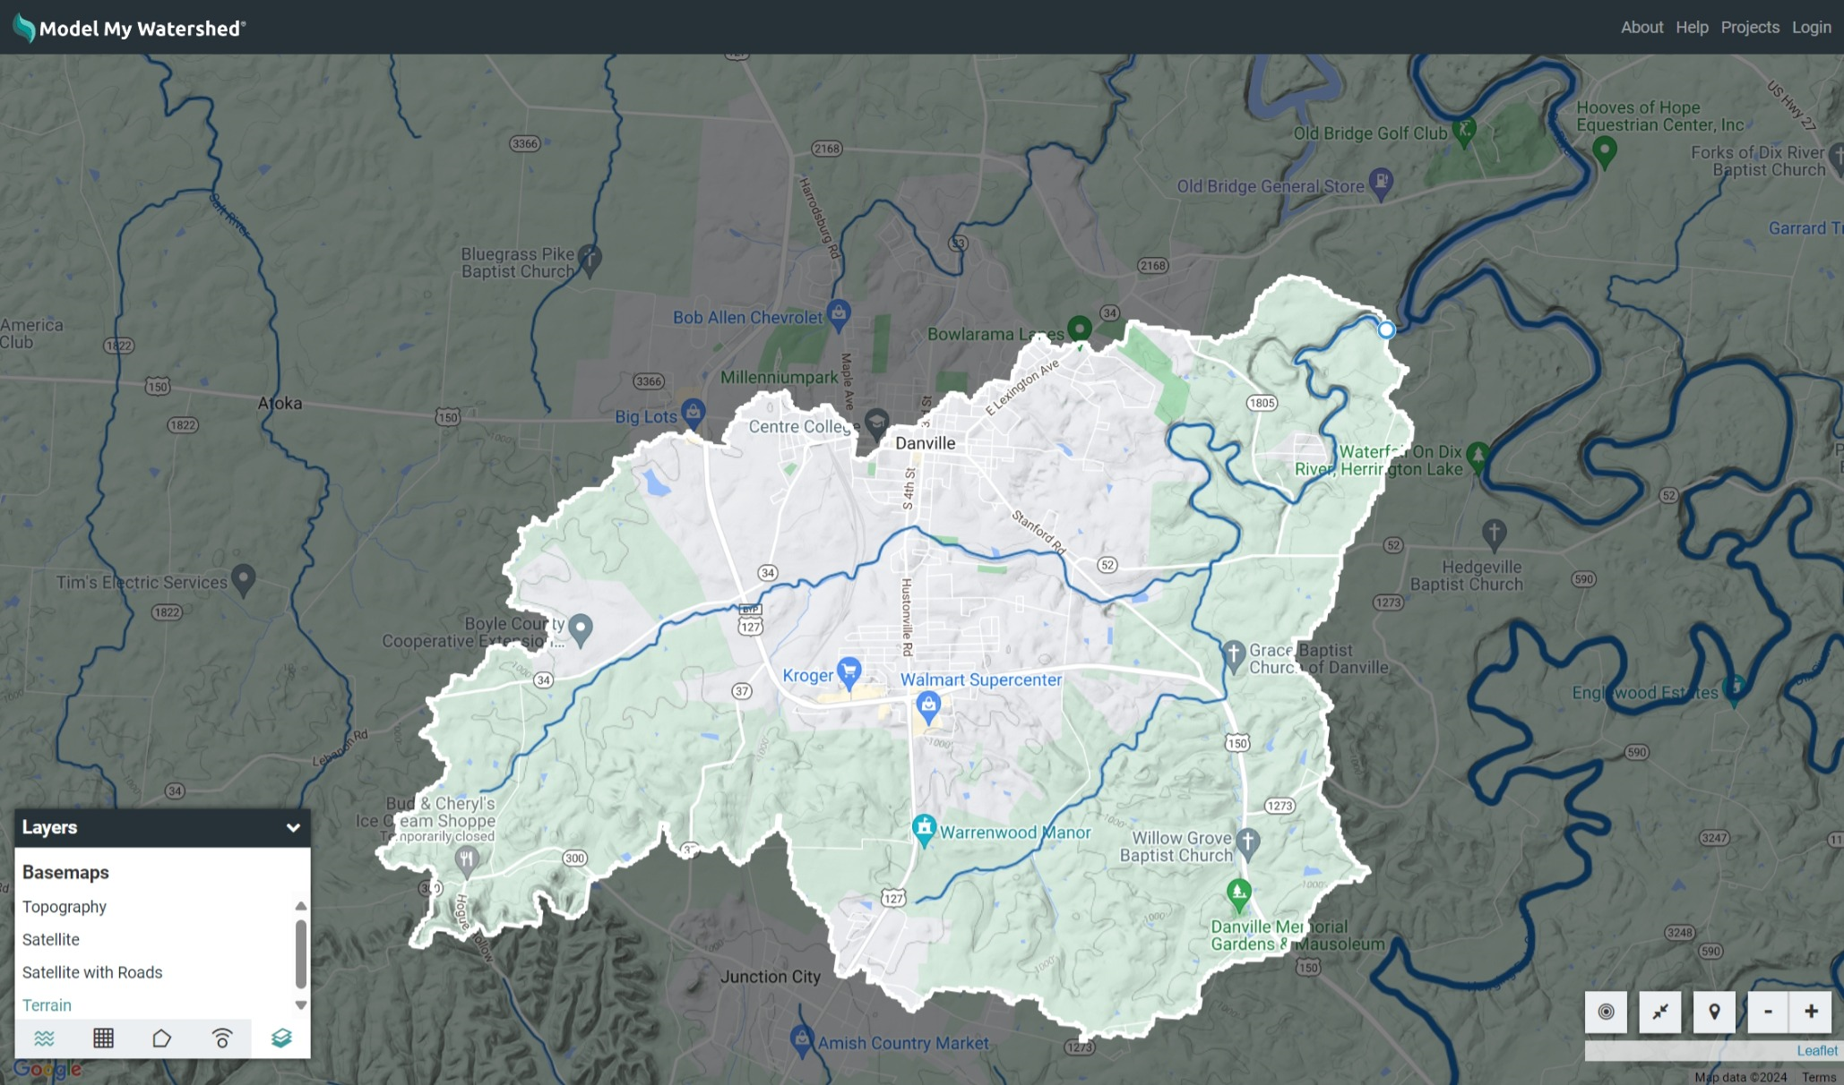
Clarks Run watershed includes 2/3 of the city and most of the eastern portion of Boyle County.

Slide 8
A couple of case studies
Local trails initiative
Natural gas liquids pipeline issue
Dead animal removal issue
Collaboration with Danville Public Works projects
Environmental assessment of water quality

Slide 9
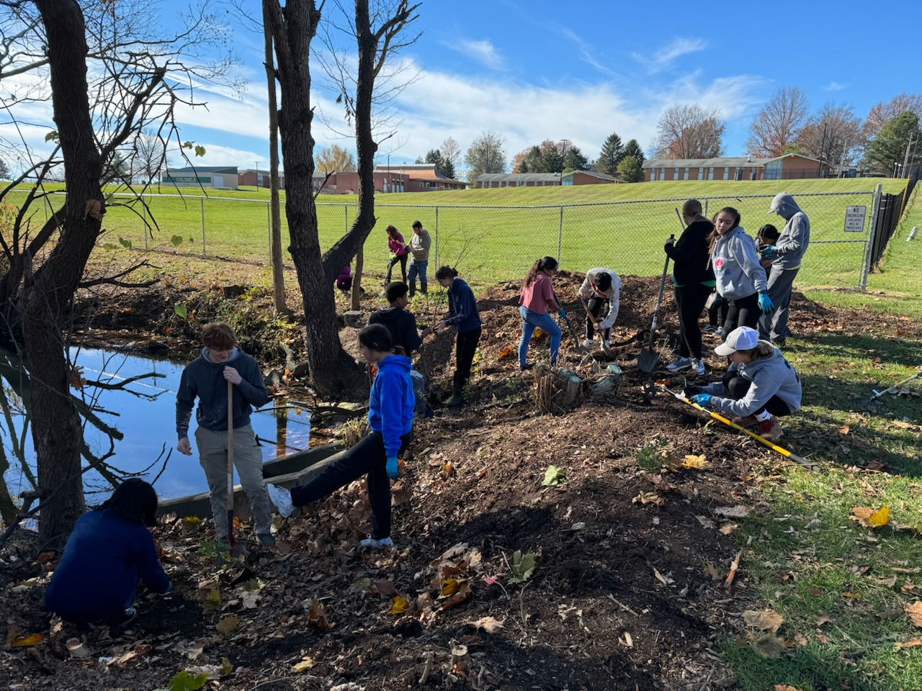
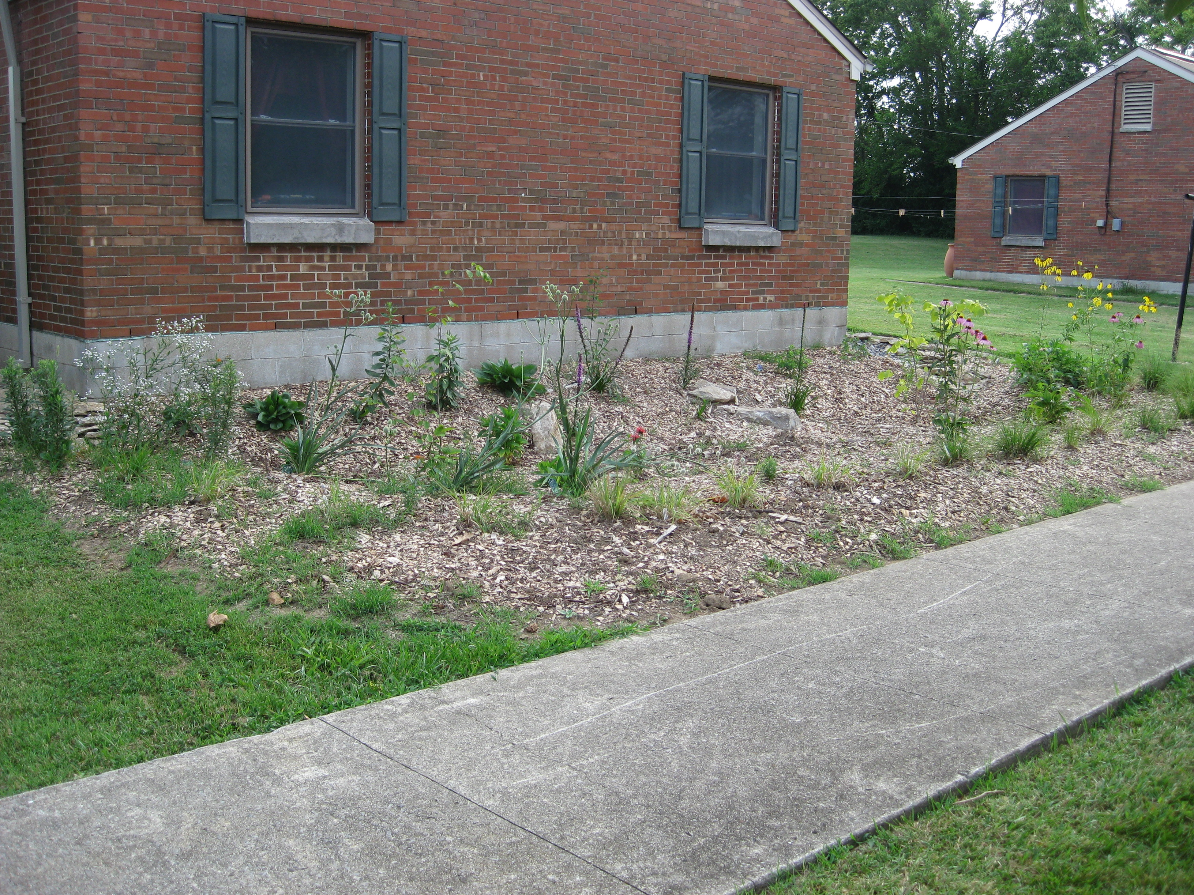
Rain garden installed at Bate- Wood Homes by Danville Housing Authority, 2009
DHS Roots & Shoots at Town Creek restoration, 2023

