Slide 4
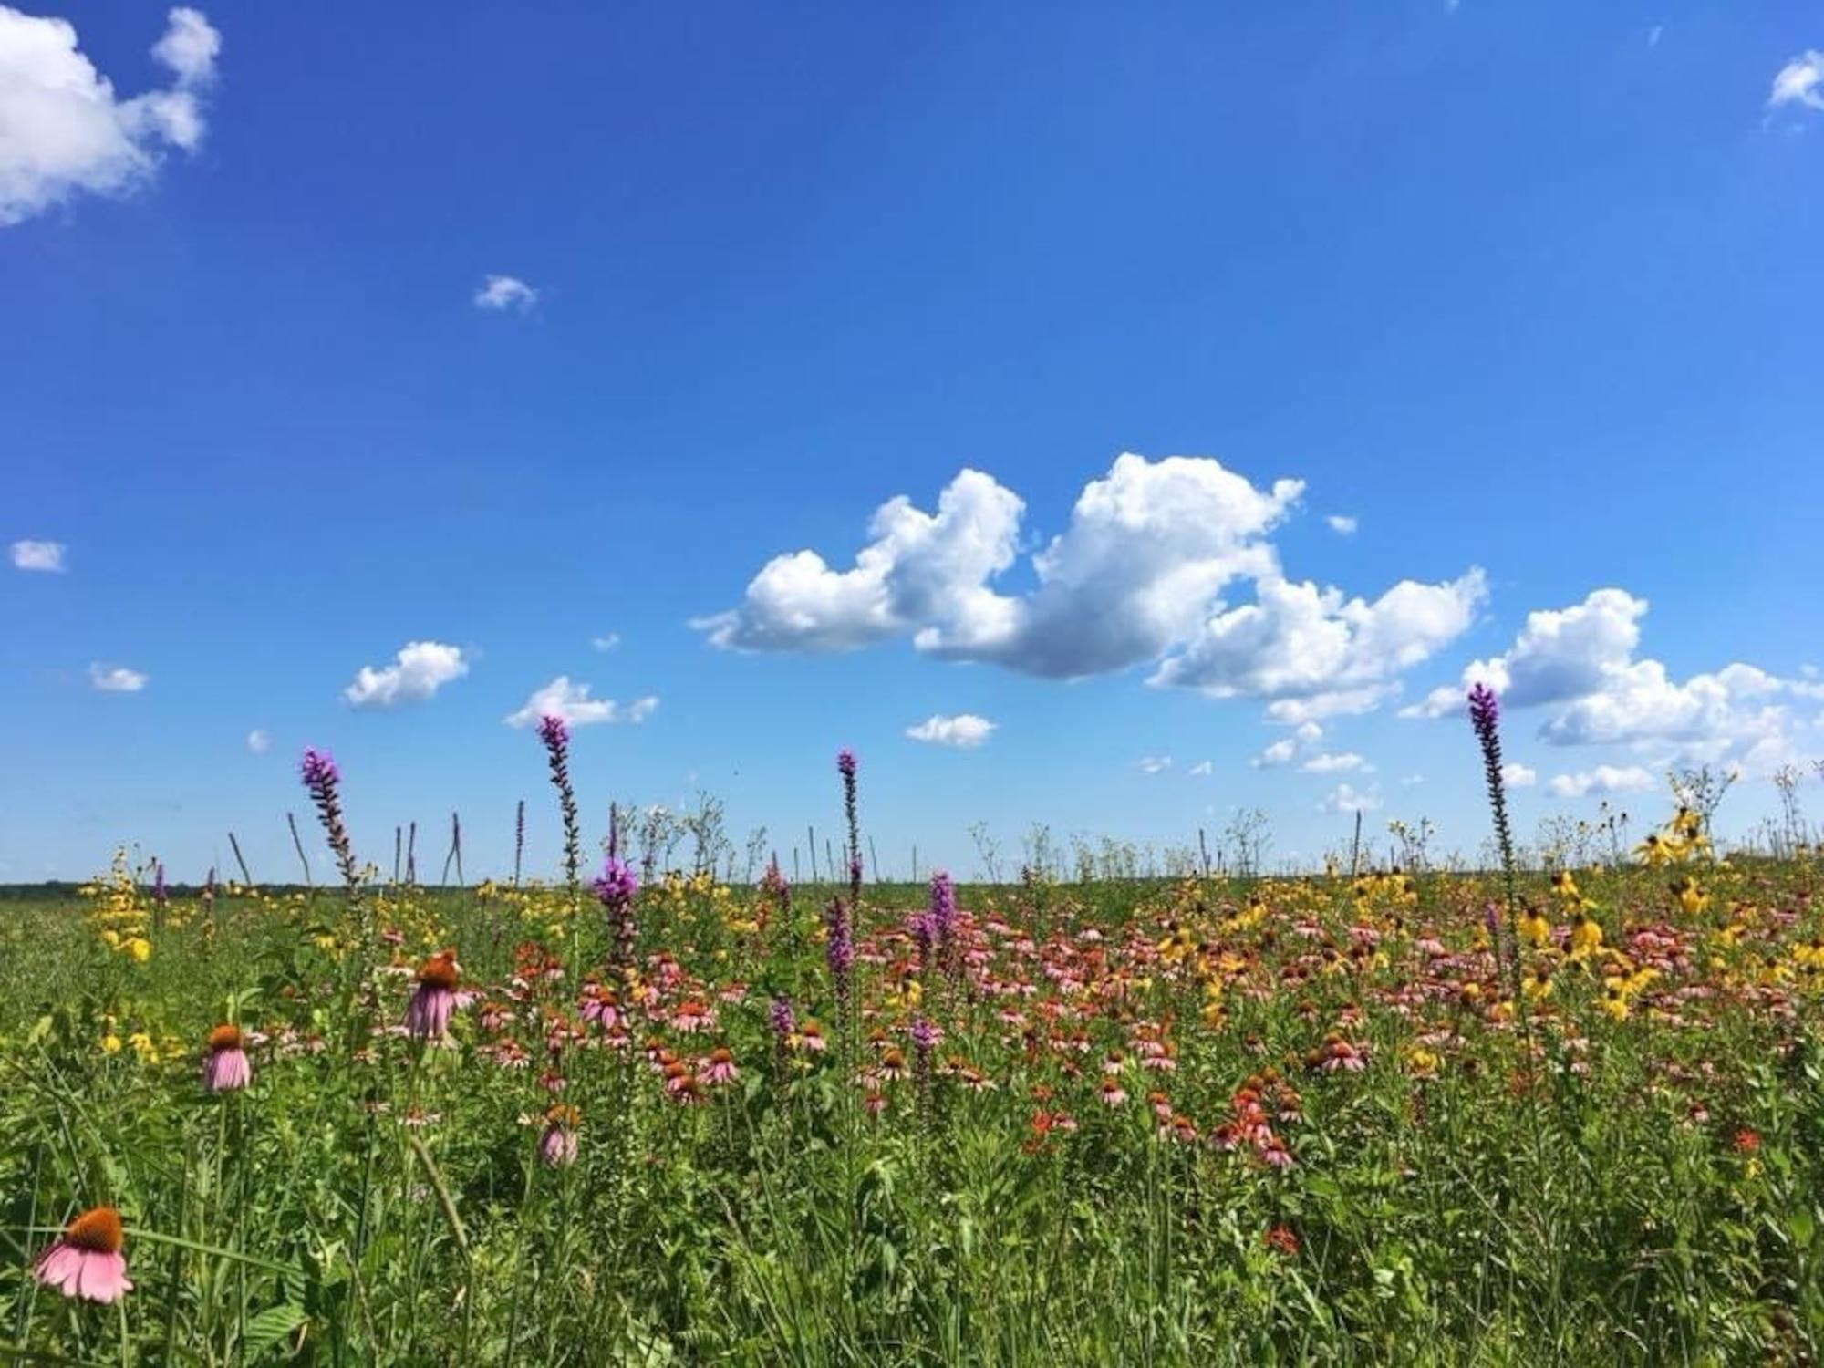
What is “sustainability”?
Environmental health
Social equity
Economic vitality
creates thriving and resilient communities for this generation and generations to come!
Healthy air
Healthy future for all (who call Earth “home”)!
Healthy habitats, ,
and communities
Healthy waters
Healthy soils

Slide 5
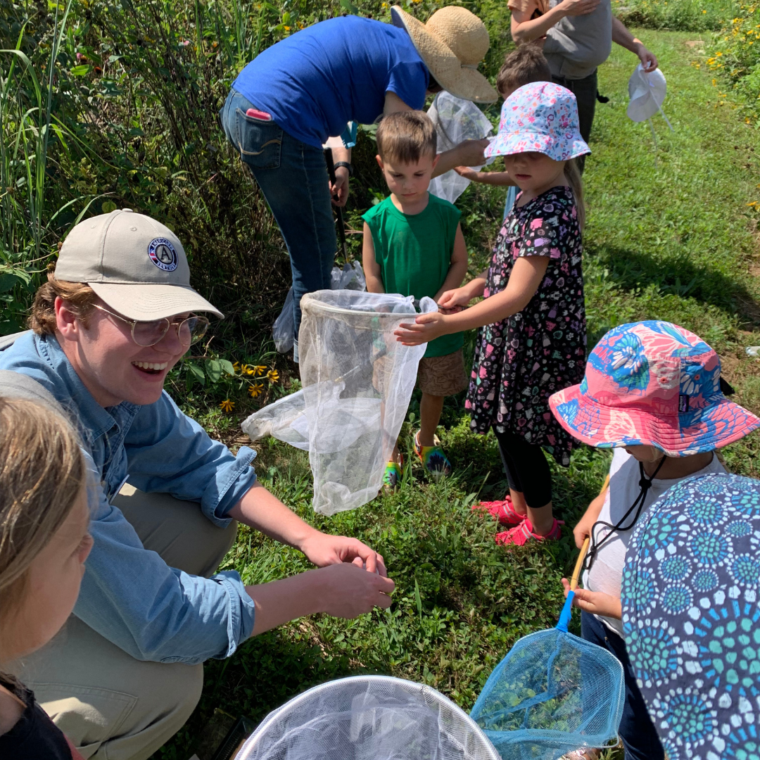
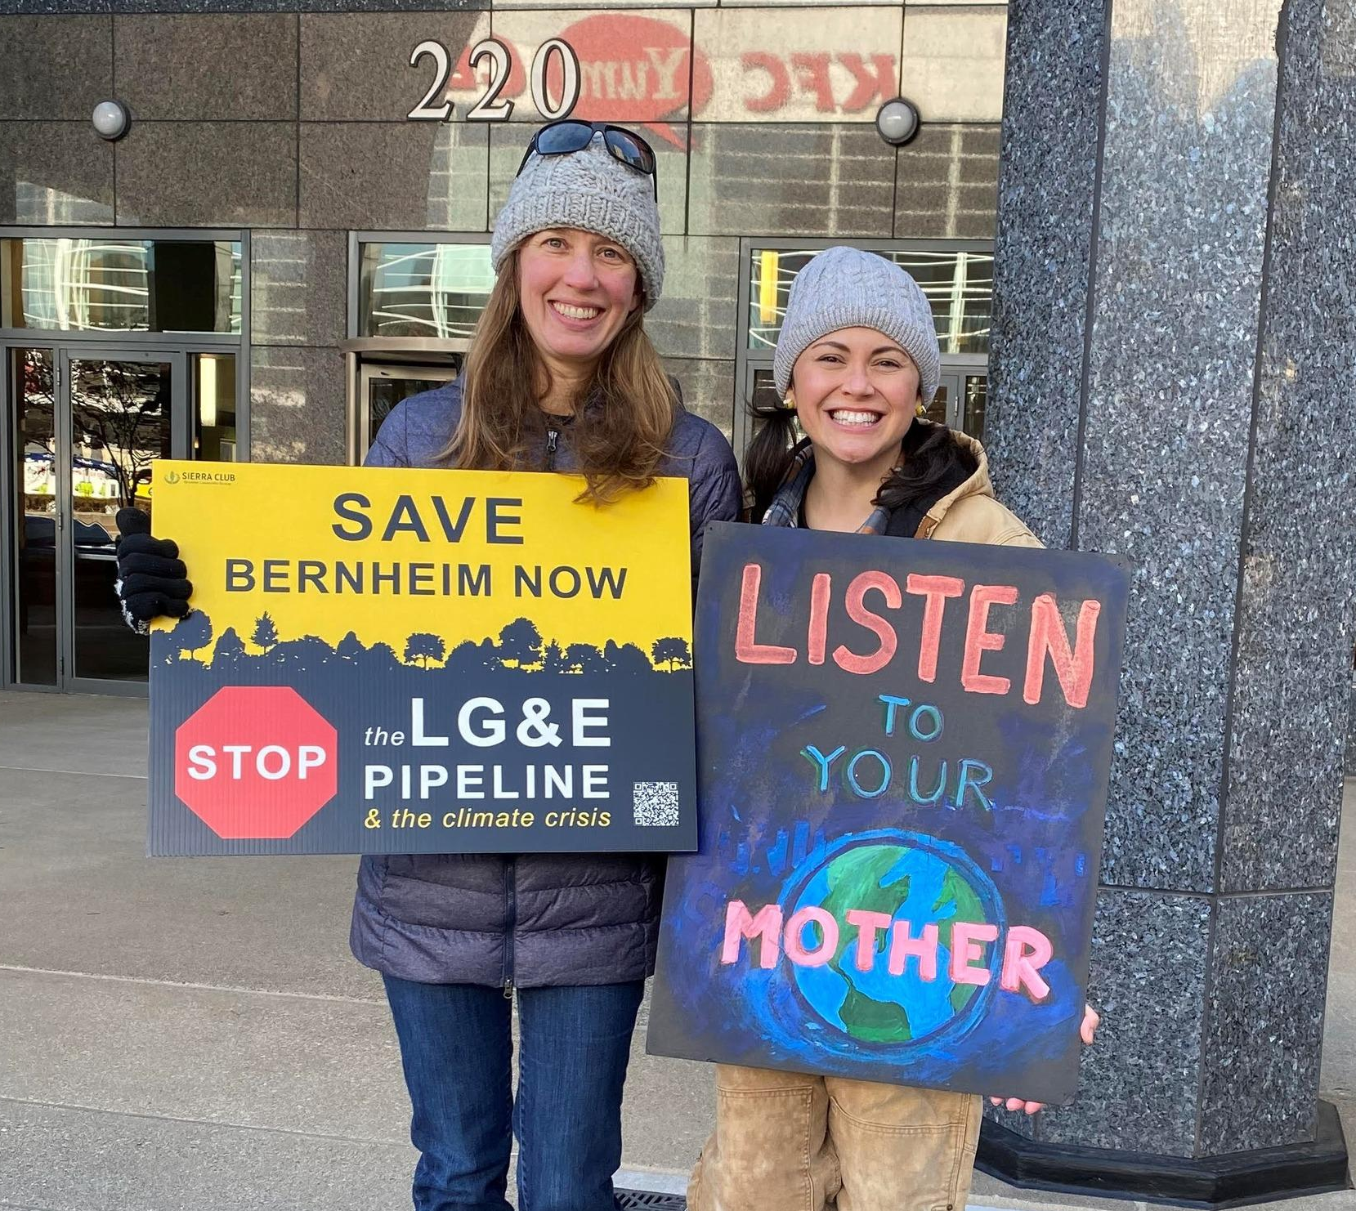
About New Pioneers
Mission
Promoting sustainability in rural communities to ensure a healthy future for all
New Pioneers . . . educates, demonstrates, and advocates!

Slide 6
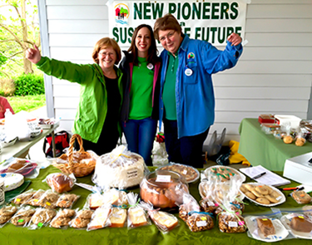
New Pioneers’ legacy

Slide 7
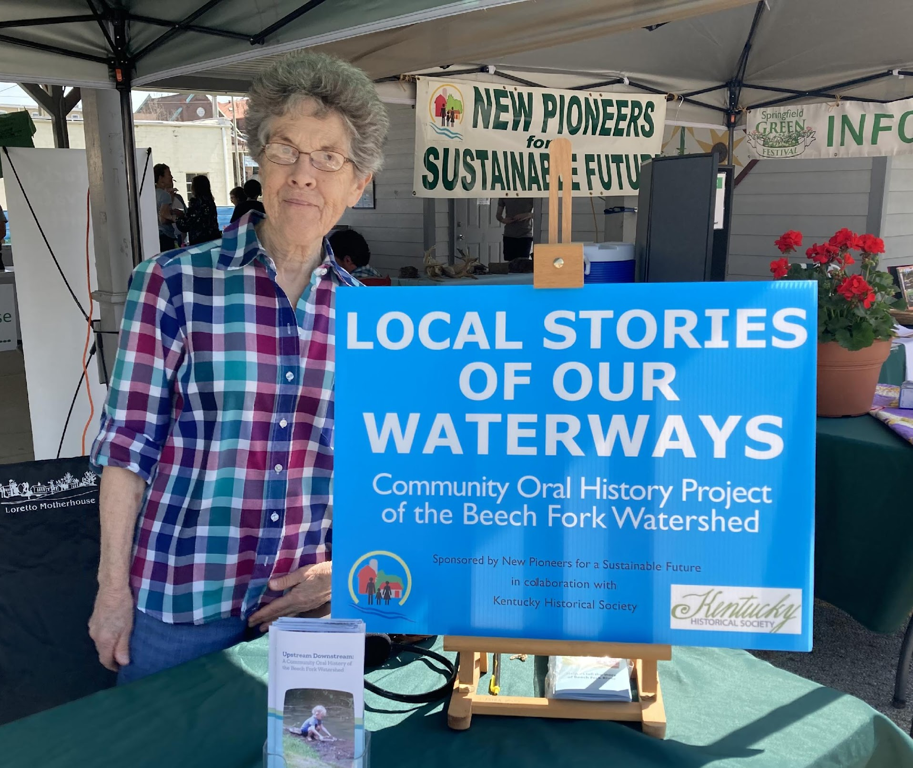
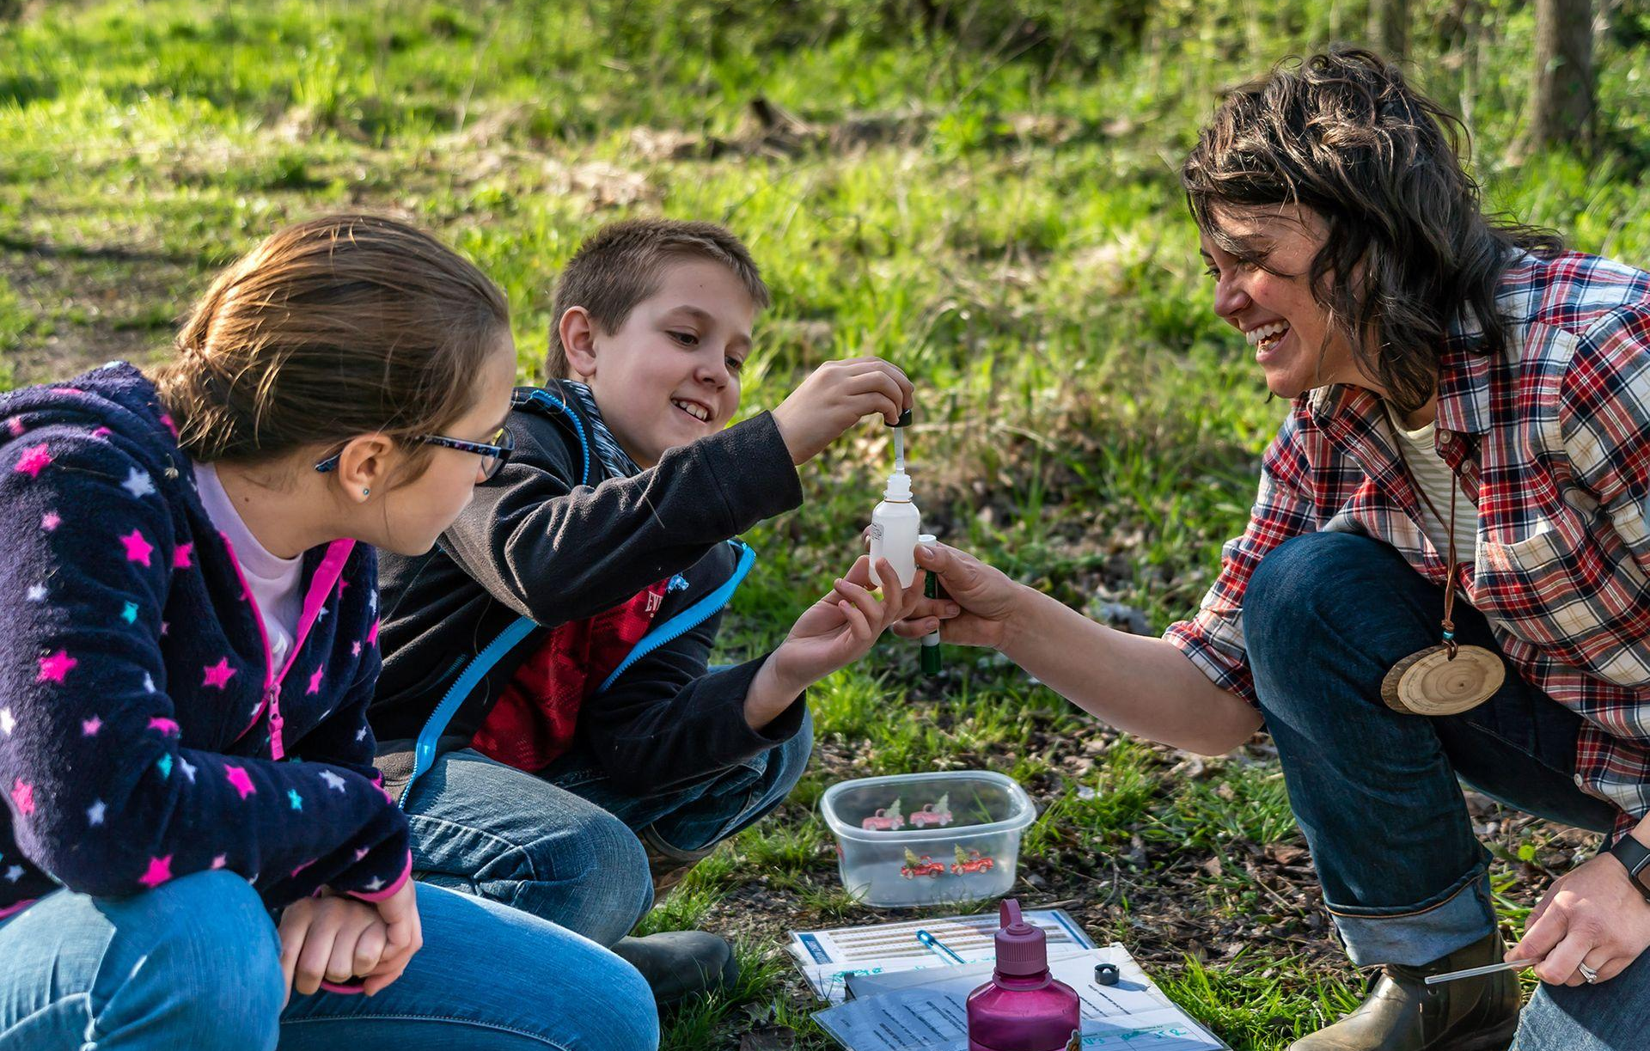
Programs and initiatives
A sustainable future is community driven, based, and aligned!

Slide 9
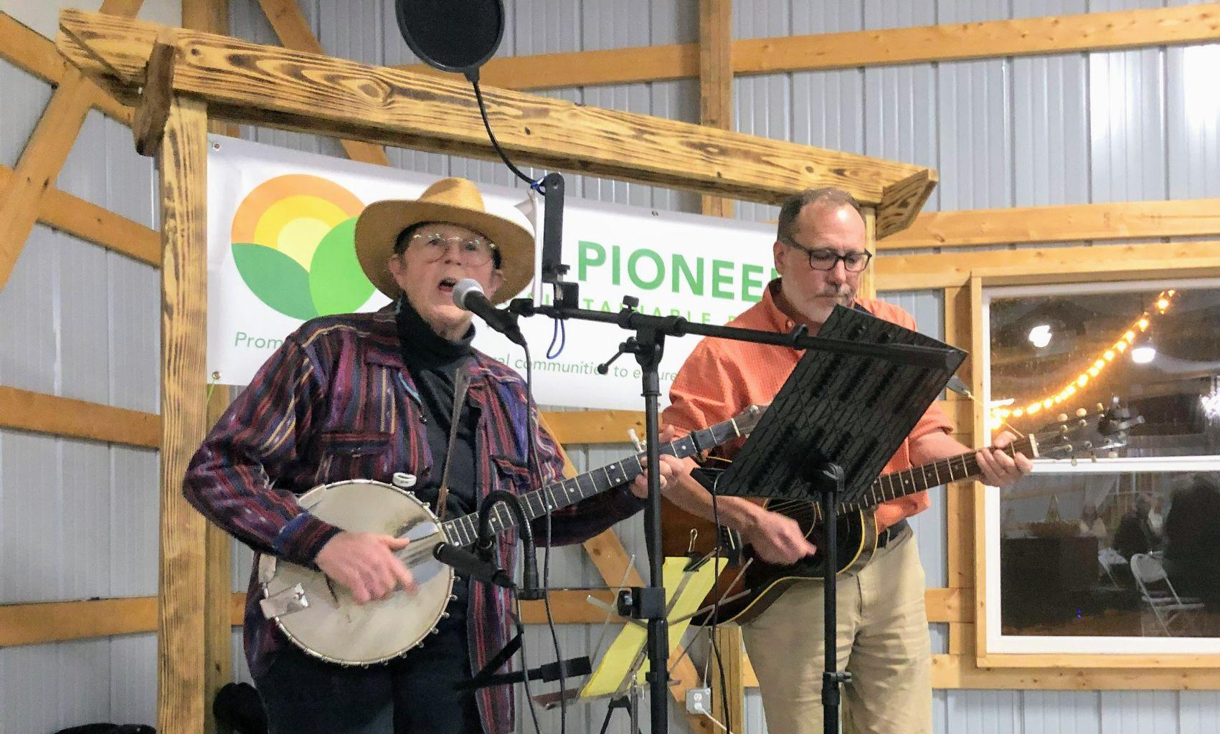
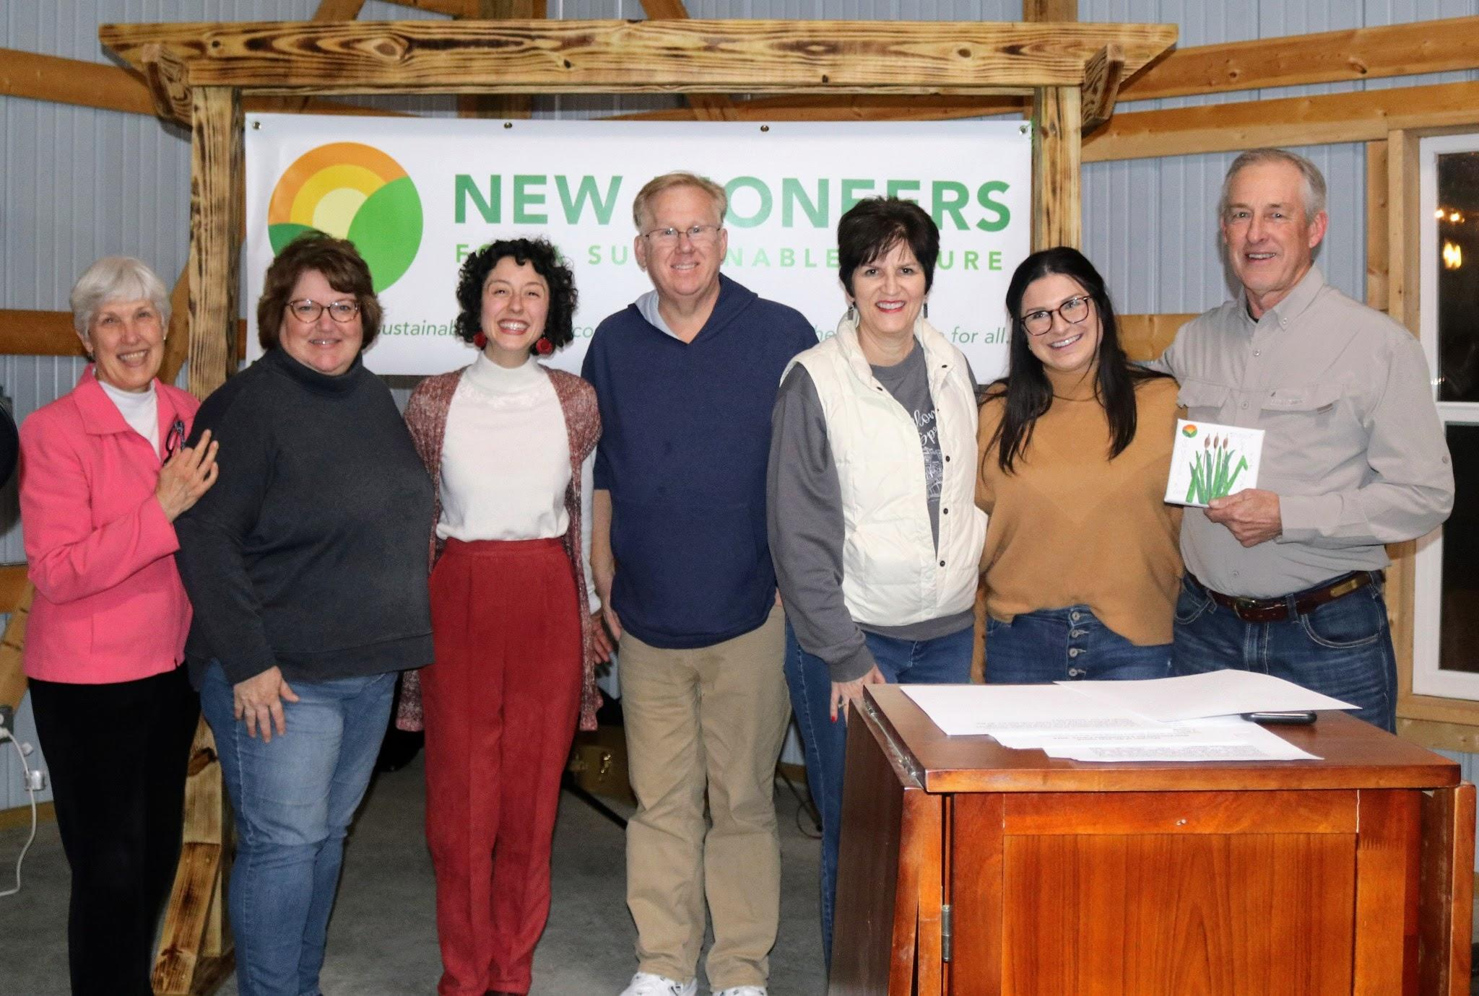
Join us!
Become a member at newpioneers.org/membership
Subscribe to our newsletter at newpioneers.org/
Follow us on Facebook (@New Pioneers for a Sustainable Future)
Join us at this year’s Green Festival on Saturday, June 15 from 10-3 p.m.!
Learn more at newpioneers.org!

Slide 10
Thank you & questions
Julia Gerwe
Executive Director
julia@newpioneers.org
(859) 336-5070
New Pioneers for a Sustainable Future
127 W Main St. Springfield KY 40069
newpioneers.org

